Slide 1
Introduction
SQL is also pronounced as “Sequel”
A de-facto standard for relational DBMS
The standard accepted by bodies like ANSI and ISO

Slide 2
Introduction
The first commercial DBMS that supported SQL in 1979 was Oracle
Another form of query language is Query-by-Example (QBE) supported by PC-based DBMSs

Slide 3
History
Relational data model introduced by Codd in 1970
A relational DBMS project started by IBM was System R which included a sequel as a manipulation language

Slide 4
History
The first commercial DBMS launched was Oracle in 1979
Other early DBMSs DB2, INGRES
ANSI and ISO defined the first standard of SQL in 1986 known as SQL-86 which was further extended to SQL-89

Slide 5
History
Later two more standards known as SQL-92 and SQL-99 were defined
Almost all of the current DBMSs support SQL-92 and many support SQL-99 partially or completely
SQL today is supported in all sort of machines

Slide 6
Benefits of Standard SQL
Reduced training cost
Application portability
Application longevity
Reduced dependence on a single vendor
Cross-system communication

Slide 7
SQL
SQL is used for any type of interaction with the database through DBMS
Right from creating a database, tables, views, users
Insertion, updation, and deletion of data in the database

Slide 8
SQL and DBMSs
Implementation of SQL always includes the flavor of the particular DBMS, like in the names of data types
Proprietary SQLs exist, like T-SQL and PL-SQL

Slide 9
DBMS
The DBMS for our course is Oracle Database and MySQL

Slide 10
INTRODUCTION
A programing language is designed to communicate a series of instructions so that those instructions can be executed
In the field of IT, programming languages are used to communicate with computer hardware and software
E.g. To create new computer programs
E.g. To direct computer programs to take certain actions

Slide 11

INTRODUCTION
Over the years, many programming languages have been created, each with its advantages and disadvantages
Figure 01

Slide 12

Structured Query Language (SQL)
The structured query language (SQL) is the standard programming language for interacting with the relational database management system (RDBMS)
RDBMS
instructions using SQL

Slide 13



Structured Query Language (SQL)
As SQL is a standard, is supported by all the major RDBMS vendors.
…
instructions using SQL

Slide 14
Structured Query Language (SQL)
According to the standard, SQL can be thought of as consisting of two major components
SQL
DDL (Data Definition Language)
Defining the database structure (e.g. defining tables needed) and controlling access to the data (e.g. Create/alter/delete)
DML (Data Manipulation Language)
Retrieving and modifying data

Slide 15
Manipulating Databases Using SQL
There are three ways that one can manipulate databases using SQL
Create a database
List the databases
Delete a database

Slide 16
Manipulating Databases Using SQL
Create a database
You should always end an SQL statement with a semicolon
SQL syntax:
For example, to create a database named “Amazon”
CREATE DATABASE <database_name>;
CREATE DATABASE Amazon;

Slide 17
Manipulating Databases Using SQL
List the databases
SQL syntax:
For example, to see a list of all the databases that have been created in MySQL
SHOW DATABASES;
SHOW DATABASES;

Slide 18
Manipulating Databases Using SQL
Delete a database
SQL syntax:
For example, to delete the database named “Amazon”
DROP DATABASE <database_name>;
DROP DATABASE Amazon;

Slide 19
Manipulating Tables Using SQL
Select a database
Tables can only exist within a database. Therefore one needs to select a database first before one can perform table manipulation. The SQL syntax is:
For example, to select a database named “Amazon”
USE <database_name>;
USE Amazon;

Slide 20
Manipulating Tables Using SQL
With a database selected, all the table manipulation using SQL would now occur within the selected database
Create a table
List the tables
Examine a table
Alter an existing table
Delete a table

Slide 21
Manipulating Tables Using SQL
Create a table
A column name cannot have any spaces
SQL syntax:
CREATE TABLE <table_name>
(
<column_name> <data_type>,
<column_name> <data_type>,
…
<column_name> <data_type>
);
No comma for the last column

Slide 22
Manipulating Tables Using SQL
Create a table
To store text in a column, choose from the following data types
Data Type | Meaning | Example
CHAR(n) | If all the data have the same number of characters, use CHAR(n) | E.g. Gender CHAR(1) The data is either 'M' or 'F', both are 1 character
VARCHAR(n) | If all the data have different number of characters, use VARCHAR(n) | E.g. LastName VARCHAR(20) The data cannot have more than 20 characters

Slide 23
Manipulating Tables Using SQL
Create a table
To store text in a column, choose from the following data types
Data Type | Meaning | Example
ENUM(valid_text1, valid_text2…) | Provide a list of allowed text for a column. Any text not listed will result in error | E.g. DepartmentName ENUM('Information Technology', 'Business', 'Engineering') Only three valid pieces of text is allowed: Information Technology, Business and Engineering
Every allowed text needs to be enclosed in quotes ('')

Slide 24
Manipulating Tables Using SQL
Create a table
To store numbers in a column, choose from the following data types
Data Type | Meaning | Example
INT | Column can store any integer from that is between -2147483648 to 2147483648 | E.g. Quantity INT
DECIMAL(m, n) | Column can store m digits with n of the digits being after the decimal point (.) | E.g. Salary DECIMAL(5, 2) The input data must be between -999.99 and 999.99

Slide 25
Manipulating Tables Using SQL
Create a table
To store numbers in a column, choose from the following data types
Data Type | Meaning | Example
INT | Column can store any integer from that is between -2147483648 to 2147483648 | E.g. Quantity INT
DECIMAL(m, n) | Column can store m digits with n of the digits being after the decimal point (.) | E.g. Salary DECIMAL(5, 2) The input data must be between -999.99 and 999.99
X
There are 10 digits:
0, 1, 2, 3, 4, 5, 6, 7, 8, 9

Slide 26
Manipulating Tables Using SQL
Create a table
To store date and time in a column, choose from the following data types
Data Type | Meaning | Example
DATE | Column can store date that is in the format of ‘year-month-day’ | E.g. Birthdate DATE Data could be '1998-09-04'
DATETIME | Column can store both date and time that is in the format of ‘year-month-day hour:minute:second’ | E.g. Arrival DATETIME Data could be '2011-11-14 09:41:30'

Slide 27
Manipulating Tables Using SQL
Create a table
For example, to create a “Book” table with the following columns
Column Name | Data Type
ISBN | Integer
Title | Characters (No more than 100 characters)
Quantity | Integer

Slide 28
Manipulating Tables Using SQL
Create a table
The SQL would be as follows
If you execute this SQL, a table named “Book” with 3 columns would be created
CREATE TABLE Book
(
ISBN INT,
Title VARCHAR(100),
Quantity INT
);

Slide 29
Manipulating Tables Using SQL
List the tables
SQL syntax:
For example, to see a list of all the tables that have been created within the selected database
SHOW TABLES;
SHOW TABLES;

Slide 30
Manipulating Tables Using SQL
Examine a table
SQL syntax:
DESCRIBE provides information about the columns of the table including
Column name, data type, whether the column accepts null or not, is the column a primary key, etc.
DESCRIBE <table_name>;

Slide 31
Manipulating Tables Using SQL
Examine a table
For example, to figure out the data type assigned to each column of the “Book” table
Output of executing the SQL
DESCRIBE Book;
Field | Type | Null | …
ISBN | int(11) | YES | …
Quantity | int(11) | YES | …
Title | varchar(100) | YES | …
Metadata

Slide 32
Manipulating Tables Using SQL
Alter an existing table
There are three ways that one can alter an existing table
Add a column
Altering Table
Alter a column
Delete a column

Slide 33
Manipulating Tables Using SQL
Add a column
SQL syntax:
For example, to add a column named “NumOfPages” of type INT to the “Book” table
ALTER TABLE <table_name> ADD <column_name> <data_type>;
ALTER TABLE Book ADD NumOfPages INT;

Slide 34
Manipulating Tables Using SQL
Alter a column
SQL syntax:
For example, to change the column named “Title” to “Title1” with data type of VARCHAR(120)
ALTER TABLE <table_name> CHANGE <column_name> <new_column_name> <new_data_type>;
ALTER TABLE Book CHANGE Title Title1 VARCHAR(120);

Slide 35
Manipulating Tables Using SQL
Alter a column
SQL syntax:
For example, to change the data type of “Title” to VARCHAR(120)
ALTER TABLE <table_name> CHANGE <column_name> <new_column_name> <new_data_type>;
ALTER TABLE Book CHANGE Title Title VARCHAR(120);

Slide 36
Manipulating Tables Using SQL
Delete a column
SQL syntax:
For example, to delete the column “NumOfPages” from the “Book” table
ALTER TABLE <table_name> DROP <column_name>;
ALTER TABLE Book DROP NumOfPages;

Slide 37
Manipulating Tables Using SQL
Delete a table
SQL syntax:
For example, to delete the table named “Book”
DROP TABLE <table_name>;
DROP TABLE Book;

Slide 38
Manipulating Tables Using SQL
Enforcing Data Integrity Using SQL
Since data are stored in tables, MySQL therefore enforce data integrity (i.e. data correctness) by allowing restrictions to be placed on the tables
NOT NULL
UNIQUE
PRIMARY KEY
FOREIGN KEY

Slide 39
Manipulating Tables Using SQL
Enforcing Data Integrity Using SQL
NOT NULL
By declaring a column as NOT NULL, this ensures that the column values cannot be NULL. SQL syntax is:
CREATE TABLE <table_name>
(
<column_name> <data_type> NOT NULL,
…
);

Slide 40
Manipulating Tables Using SQL
Enforcing Data Integrity Using SQL
NOT NULL
For example, to ensure that every book must have a non NULL “Title”
CREATE TABLE Book
(
ISBN INT,
Title VARCHAR(100) NOT NULL,
Quantity INT
);

Slide 41
Manipulating Tables Using SQL
Enforcing Data Integrity Using SQL
NOT NULL
To set a column to NOT NULL in an existing table, the SQL syntax is:
For example, to set the column “Title” to NOT NULL
ALTER TABLE <table_name> CHANGE <column_name> <new_column_name> <new_data_type> NOT NULL;
ALTER TABLE Book CHANGE Title Title VARCHAR(100) NOT NULL;

Slide 42
Manipulating Tables Using SQL
Enforcing Data Integrity Using SQL
UNIQUE
By declaring a column as UNIQUE, this ensures that every column value is different. SQL syntax is:
CREATE TABLE <table_name>
(
<column_name> <data_type> UNIQUE,
…
);

Slide 43
Manipulating Tables Using SQL
Enforcing Data Integrity Using SQL
UNIQUE
For example, to ensure that every book has a non NULL and unique title
CREATE TABLE Book
(
ISBN INT,
Title VARCHAR(100) NOT NULL UNIQUE,
Quantity INT
);
You can have multiple constraints per column

Slide 44
Manipulating Tables Using SQL
Enforcing Data Integrity Using SQL
UNIQUE
To set a column to UNIQUE in an existing table, the SQL syntax is:
For example, to set the column “Title” to UNIQUE
ALTER TABLE <table_name> CHANGE <column_name> <new_column_name> <new_data_type> UNIQUE;
ALTER TABLE Book CHANGE Title Title VARCHAR(100) UNIQUE;

Slide 45
Manipulating Tables Using SQL
Enforcing Data Integrity Using SQL
PRIMARY KEY
By declaring a column as a PRIMARY KEY, this ensures that every column value is different
Comparison of UNIQUE and PRIMARY KEY
UNIQUE | PRIMARY KEY
Every column value is different | Every column value is different
A table can have many UNIQUE columns | A table can only have one PRIMARY KEY column
No data retrieval optimization | Data retrieval using the primary key is optimized to be fast

Slide 46
Manipulating Tables Using SQL
Enforcing Data Integrity Using SQL
PRIMARY KEY
The SQL syntax for declaring a column as a PRIMARY KEY is:
CREATE TABLE <table_name>
(
<column_name> <data_type> PRIMARY KEY,
…
);

Slide 47
Manipulating Tables Using SQL
Enforcing Data Integrity Using SQL
PRIMARY KEY
If the primary key consists of more than one column, the SQL syntax is:
CREATE TABLE <table_name>
(
…,
PRIMARY KEY(<col_name>, <col_name> …)
);
The PRIMARY KEY declaration is on its own line

Slide 48
Manipulating Tables Using SQL
Enforcing Data Integrity Using SQL
PRIMARY KEY
For example, suppose the primary key for the Book table is ISBN
CREATE TABLE Book
(
ISBN INT PRIMARY KEY,
Title VARCHAR(100),
Quantity INT
);
CREATE TABLE Book
(
ISBN INT,
Title VARCHAR(100),
Quantity INT,
PRIMARY KEY(ISBN)
);
Both SQL statements produce the same table

Slide 49
Manipulating Tables Using SQL
Enforcing Data Integrity Using SQL
PRIMARY KEY
For example, suppose the primary key for the Class table is class code and class section
CREATE TABLE Class
(
Code CHAR(6),
Section CHAR(6),
Name VARCHAR(50),
PRIMARY KEY(Code, Section)
);

Slide 50
Manipulating Tables Using SQL
Enforcing Data Integrity Using SQL
PRIMARY KEY
For example, suppose the primary key for the Class table is class code and class section
CREATE TABLE Class
(
Code CHAR(6) PRIMARY KEY,
Section CHAR(6) PRIMARY KEY,
Name VARCHAR(50),
);
DBMS will interpret this as the declaration of two primary keys. It will display an error message

Slide 51
Manipulating Tables Using SQL
Enforcing Data Integrity Using SQL
PRIMARY KEY
To set a column as a PRIMARY KEY in an existing table, the SQL syntax is:
For example, to set “ISBN” as a PRIMARY KEY
ALTER TABLE <table_name> ADD PRIMARY KEY(<column_name>, <column_name>…) ;
ALTER TABLE Book ADD PRIMARY KEY(ISBN);

Slide 52
Manipulating Tables Using SQL
Enforcing Data Integrity Using SQL
FOREIGN KEY
By declaring a column as a FOREIGN KEY, this ensures that its values will refer to an existing primary key of a related table or is set to NULL. SQL syntax is:
CREATE TABLE <table_name>
(
…,
FOREIGN KEY(<column_name>) REFERENCES <table_name>(<table_column_name>)
);
The FOREIGN KEY declaration is on its own line

Slide 53
Manipulating Tables Using SQL
Enforcing Data Integrity Using SQL
FOREIGN KEY
For example, suppose there are two tables: “Book” table and “Author” table
CREATE TABLE Book
(
ISBN INT PRIMARY KEY,
Title VARCHAR(100),
AuthorId INT,
FOREIGN KEY(AuthorId) REFERENCES Author(Id)
);
CREATE TABLE Author
(
Id INT PRIMARY KEY,
Name VARCHAR(50)
);
“AuthorId” is a foreign key that points to the “Author” table’s “Id” column

Slide 54
Manipulating Tables Using SQL
Enforcing Data Integrity Using SQL
FOREIGN KEY
Which of the SQL statements should be executed first?
CREATE TABLE Book
(
ISBN INT PRIMARY KEY,
Title VARCHAR(100),
AuthorId INT,
FOREIGN KEY(AuthorId) REFERENCES Author(Id)
);
CREATE TABLE Author
(
Id INT PRIMARY KEY,
Name VARCHAR(50)
);
1
The “Author” table is mentioned here. If the table does not exist, executing this SQL will cause an error
2

Slide 55
Manipulating Tables Using SQL
Enforcing Data Integrity Using SQL
FOREIGN KEY
By declaring “AuthorId” as a foreign key, this means
ISBN | Title | AuthorId
12345 | The Hunger Game | 1
54321 | A Song of Ice and Fire | NULL
12321 | The Wheel of Time | 2
Valid foreign key value as there is an author with ID of 1
Valid foreign key value as author is unknown
Invalid foreign key value as there is no author with ID of 2
Book table
This foreign key value will cause an error message to be displayed
Id | Name
1 | Suzanne Collins
Author table

Slide 56
Manipulating Tables Using SQL
Enforcing Data Integrity Using SQL
FOREIGN KEY
To set a column as a FOREIGN KEY in an existing table, the SQL syntax is:
For example, to set “AuthorID” as a FOREIGN KEY
ALTER TABLE <table_name> ADD FOREIGN KEY(<column_name>) REFERENCES <table_name>(<table_column_name>);
ALTER TABLE Book ADD FOREIGN KEY(AuthorID) REFERENCES Author(ID);

Slide 57
Manipulating Tables Using SQL
Other Table Related SQL
Default
During data entry, when no data is provided for a column, MySQL would try to enter the data on behalf of the user based on the following rules
If the column has a default value assigned to it
If the column has no default value but can accept NULL
If the column has no default value and cannot accept NULL
The default value would be assigned as the column data
The NULL value would be assigned as the column data
MySQL would throw out an error message thereby denying the data entry
We will be learning how to set a default value for a column using SQL

Slide 58
Manipulating Tables Using SQL
Other Table Related SQL
Default
The SQL syntax for setting the default value for a column is:
CREATE TABLE <table_name>
(
<column_name> <data_type> DEFAULT <value>,
…
);

Slide 59
Manipulating Tables Using SQL
Other Table Related SQL
Default
For example, if “Quantity” is omitted from data entry, we want the default to be set to 10
CREATE TABLE Book
(
ISBN INT PRIMARY KEY,
Title VARCHAR(100),
Quantity INT DEFAULT 10
);

Slide 60
Manipulating Tables Using SQL
Other Table Related SQL
Default
To set the DEFAULT value for a column in an existing table, the SQL syntax is:
For example, to set the DEFAULT of “Quantity” to 10
ALTER TABLE <table_name> CHANGE <column_name> <new_column_name> <new_data_type> DEFAULT <value>;
ALTER TABLE Book CHANGE Quantity Quantity INT DEFAULT 10;

Slide 61
Activity 1
CLASS ACTIVITY
Write down the SQL statements for creating the following tables
Column Name | Data Type | Constraint
TeamId | Characters (Exactly 3 characters) | Primary key
Name | Characters (No more than 50 characters) | Cannot be NULL, Unique
Team table
Column Name | Data Type | Constraint
MemberId | Integer | Primary key
Name | Characters (No more than 50 characters) | Cannot be NULL
Team | Characters (Exactly 3 characters) | Foreign key
Member table
Answer

Slide 62
Activity 1
CLASS ACTIVITY
Answer
CREATE TABLE Team
(
TeamId CHAR(3) PRIMARY KEY,
Name VARCHAR(50) NOT NULL UNIQUE
);
CREATE TABLE Member
(
MemberId INT PRIMARY KEY,
Name VARCHAR(50) NOT NULL,
Team CHAR(3),
FOREIGN KEY(Team) REFERENCES Team(TeamId)
);

Slide 63
Manipulating Data Using SQL
There are four ways that one can manipulate data using SQL
INSERT
SELECT
UPDATE
DELETE

Slide 64
Manipulating Data Using SQL
INSERT
INSERT can be used to add data into a table. The SQL syntax is
Note that the order of the data values is based on the order of the columns of the table
INSERT INTO <table_name> VALUES(<data_value1>, <data_value2>…);
<data_value1> → 1st table column
<data_value2> → 2nd table column

Slide 65
Manipulating Data Using SQL
INSERT
For example, given the following “Book” table
To insert a book into the “Book” table
ISBN | Title | Quantity
Book table
INSERT INTO Book VALUES(123, 'The Hunger Game', 5);
Why do we quote some data values but not others?

Slide 66
Manipulating Data Using SQL
INSERT
The data values are quoted or not quoted based on the data type of the column
Data Type | Quotation Marks | Examples
CHAR(n) | YES | 'M' or 'F'
VARCHAR(n) | YES | 'John', 'Mary'
ENUM(txt1, txt2..) | YES | ‘Business', ‘Engineering'
INT | NO | 123, 22
DECIMAL(m,n) | NO | 123.22, 20.7
DATE | YES | '1979-11-11'
DATETIME | YES | '1979-11-11 20:08:30'
No need to quote numbers

Slide 67
Manipulating Data Using SQL
INSERT
If the data to be added is only for some (i.e. not all) of the table columns, the SQL syntax is
For example, to insert into columns ISBN and Title
INSERT INTO <table_name>(<column_name>, <column_name>…) VALUES(<data_value>, <data_value>…);
INSERT INTO Book(ISBN, Title) VALUES(123, 'The Hunger Game');

Slide 68
Manipulating Data Using SQL
SELECT
To display all the data in a table, the SQL syntax is:
For example, to display all the books in the “Book” table
SELECT * FROM <table_name>;
SELECT * FROM Book;

Slide 69
Manipulating Data Using SQL
SELECT
To display only certain columns of a table, the SQL syntax is:
For example, to display only the columns “ISBN” and “Title” of the “Book” table
SELECT <column_name>, <column_name>… FROM <table_name>;
SELECT ISBN, Title FROM Book;

Slide 70
Manipulating Data Using SQL
SELECT
DISTINCT can be used to remove duplicated rows. The SQL syntax is:
For example, to display only the column “Title” of the “Book” table with no duplicated titles
SELECT DISTINCT <column_name>, <column_name>… FROM <table_name>;
SELECT DISTINCT Title FROM Book;

Slide 71
Manipulating Data Using SQL
SELECT
The WHERE clause can be used to limit the rows to be displayed. The SQL syntax is:
For example, to display only those books where we have less than 5 copies
SELECT <column_name>, <column_name>… FROM <table_name> WHERE <condition>;
SELECT * FROM Book WHERE Quantity < 5;

Slide 72
Manipulating Data Using SQL
SELECT
In a <condition>, the operators supported are
Operator | Name | Example
= | Equals | WHERE Quantity = 5
<> | Not equal to | WHERE Quantity <> 5
> | Greater than | WHERE Quantity > 5
>= | Greater than or equal to | WHERE Quantity >= 5
< | Less than | WHERE Quantity < 5
<= | Less than or equal to | WHERE Quantity <= 5

Slide 73
Activity 2
CLASS ACTIVITY
Write down the SQL statements
Display the book named “The Hunger Game”
Display ISBN and Title of book with ISBN of 12
Answer
SELECT * FROM Book WHERE Title = 'The Hunger Game';
Answer
SELECT ISBN, Title FROM Book WHERE ISBN = 12;

Slide 74
Manipulating Data Using SQL
SELECT
With SELECT, one can specify multiple <condition> as well. If all the <condition> need to be satisfied, the SQL syntax is:
For example, display only those books with more than 5 copies but less than 10 copies
…WHERE <condition> AND <condition> AND <condition>…;
SELECT * FROM Book WHERE Quantity > 5 AND Quantity < 10;

Slide 75
Manipulating Data Using SQL
SELECT
If given multiple <condition> but only one of the <condition> needs to be satisfied. The SQL syntax is:
For example, display only those books where we have either 4 or 5 copies
…WHERE <condition> OR <condition> OR <condition>…;
SELECT * FROM Book WHERE Quantity = 4 OR Quantity = 5;

Slide 76
Activity 3
CLASS ACTIVITY
Write down the SQL statement
Display the ISBN and Title of books that cost more than 500.50 PKR but that we have no more than 5 copies
Answer
SELECT ISBN, Title FROM Book WHERE Price > 500.50 AND Quantity <= 5;

Slide 77
Manipulating Data Using SQL
SELECT
In SQL, there is special syntax for manipulating NULL. To check for NULL equality, the SQL syntax is:
For example, to display only those books where the quantity is unknown
… WHERE <column_name> IS NULL…;
SELECT * FROM Book WHERE Quantity IS NULL;
Writing “Quantity = NULL” will produce wrong answer

Slide 78
Manipulating Data Using SQL
SELECT
For a value not equal to NULL, the SQL syntax is:
For example, to display only those books where the quantity is known
… WHERE <column_name> IS NOT NULL…;
SELECT * FROM Book WHERE Quantity IS NOT NULL;
Writing “Quantity <> NULL” will produce wrong answer

Slide 79
Manipulating Data Using SQL
SELECT
Data in a table can be sorted based on the selected column. To sort in ascending order (i.e. from small to big or from a to z), the SQL syntax is:
For example, to display the books in the “Book” table sorted by the book’s quantity in ascending order
… ORDER BY <column_name>;
SELECT * FROM Book ORDER BY Quantity;

Slide 80
Manipulating Data Using SQL
SELECT
To sort in descending order (i.e. from big to small or from z to a), the SQL syntax is:
For example, to display the books in the “Book” table sorted by book’s title in descending order
… ORDER BY <column_name> DESC;
SELECT * FROM Book ORDER BY Title DESC;

Slide 81
Manipulating Data Using SQL
UPDATE
To change the data in a table, the SQL syntax is:
For example, to change the Book with ISBN of 123 to have the title of “1Q84” and quantity of 10
UPDATE <table_name> SET <column_name> = <value>, <column_name> = <value>… WHERE <condition>…;
UPDATE Book SET Title = '1Q84', Quantity = 10 WHERE ISBN = 123;

Slide 82
Manipulating Data Using SQL
DELETE
To remove data from a table, the SQL syntax is:
For example, to remove the book with ISBN of 123 from the “Book” table
DELETE FROM <table_name> WHERE <condition>…;
DELETE FROM Book WHERE ISBN = 123;

Slide 83
Manipulating Data Using SQL
DELETE
To remove all the data in a table, the SQL syntax is:
For example, to remove all the books in “Book” table
DELETE FROM <table_name>;
DELETE FROM Book;

Slide 84
Relational Constraints
Recall that we can enforce data integrity (i.e. data correctness) by limiting the data that can be stored in a database. A relational data model supports the following data constraints
Domain Constraint
Key Constraint
Entity Integrity Constraint
NULL Constraint
Referential Integrity Constraint

Slide 85
Relational Constraints
Domain Constraint
A relational DBMS can restrict the set of values that can be assigned to a column
Column | Domain Constraint
Name
Employee’s age
Gender
Department
Text
18 to 60
Male or Female
Computer Science, Business…

Slide 86
Relational Constraints
Key Constraint
A candidate key is a column or combination of columns that can uniquely identify each row in a relation
STUDENTID is a candidate key since it can unique identify each row (i.e. each student) in the relation
STUDENTID | NAME
1 | Talha Amjad
2 | Sara Saleem
3 | Aqib Ali
Student
Student
You can think of candidate keys as attributes that you underline in EER diagram
Student
Student relation

Slide 87
Relational Constraints
Key Constraint
In a relation, one candidate key must be chosen to be the primary key of the relation. Always underline the primary key in a relation
STUDENTID | ICNUMBER | NAME
1 | 123-321 | Talha Amjad
2 | 321-123 | Sara Saleem
3 | 132-231 | Aqib Ali
Candidate keys
STUDENTID
ICNumber
Primary key
Either STUDENTID or ICNumber
Student relation

Slide 88
Relational Constraints
Key Constraint
In a relation, one candidate key must be chosen to be the primary key of the relation. Always underline the primary key in a relation
STUDENTID | ICNUMBER | NAME
1 | 123-321 | Talha Amjad
2 | 321-123 | Sara Saleem
3 | 132-231 | Aqib Ali
Candidate keys
STUDENTID
ICNumber
Primary key
Either STUDENTID or ICNumber
Student relation

Slide 89
Relational Constraints
Key Constraint
In a relation, one candidate key must be chosen to be the primary key of the relation. Always underline the primary key in a relation
STUDENTID | ICNUMBER | NAME
1 | 123-321 | Talha Amjad
2 | 321-123 | Sara Saleem
3 | 132-231 | Aqib Ali
Candidate keys
STUDENTID
ICNumber
Primary key
Either STUDENTID or ICNumber
Student relation

Slide 90
Relational Constraints
Key Constraint
In a relational data model, a primary key must be specified for every relation
NAME | GENDER | PROGRAM
Talha Amjad | Male | BSIT
Talha Amjad | Male | BSIT
Is this a mistake or are there 2 Talha Amjad
studying BSIT?
Student relation
If the relation has a primary key such as student Id, we can check the student Id to determine whether there are 2 Talha Amjad or just one

Slide 91
Relational Constraints
Key Constraint
A relational DBMS will check each primary key value to ensure that it is unique. This is known as enforcing key constraint
STUDENTID | NAME
1 | Talha Amjad
2 | Sara Saleem
If you try to enter STUDENTID = 2 and NAME = Aqib Ali, the relational DBMS would enforce key constraint and denied your data entry since STUDENTID is a primary key
Student relation

Slide 92
Relational Constraints
Entity Integrity Constraint
A relational DBMS will check each primary key value to ensure that it is not NULL since NULL is not unique. This is known as enforcing entity integrity constraint
STUDENTID | NAME
1 | Talha Amjad
2 | Sara Saleem
If you try to enter STUDENTID = NULL and NAME = Aqib Ali, the relational DBMS would enforce entity integrity constraint and denied your data entry since STUDENTID is a primary key and cannot be NULL
Student relation

Slide 93
Relational Constraints
NULL Constraint
A relational DBMS will check each column value to ensure that it is not NULL
E.g. If you declare NULL constraint on “Name”
STUDENTID | NAME
1 | Talha Amjad
2 | Sara Saleem
If you try to enter STUDENTID = 3 and NAME = NULL, the relational DBMS would enforce NULL constraint and denied your data entry
Student relation

Slide 94
Relational Constraints
Referential Integrity Constraint
A foreign key is a column whose values match the primary key values in a related table
STUDENT ID | NAME | SUBJECT
1 | Talha Amjad | BSIT 201
2 | Sara Saleem | BSIT 301
3 | Aqib Ali | BSIT 201
SUBJECT CODE | NAME
BSIT 201 | Database Concept
BSIT 301 | Business Mathematics
Subject relation
Student relation
SUBJECT column is a foreign key
By specifying a foreign key, this allows us to link together two different relations (e.g. Talha Amjad is taking Database Concept)

Slide 95
Relational Constraints
Referential Integrity Constraint
A relational DBMS will check each foreign key value to ensure that it is either NULL or refers to an existing primary key. This is known as enforcing referential integrity constraint
STUDENT ID | NAME | SUBJECT
SUBJECT CODE | NAME
BSIT 201 | Database Concept
Student relation
Subject relation
We can enter a new student into the student relation with SUBJECT = NULL or SUBJECT = BSIT 201

Slide 96
Relational Constraints
Referential Integrity Constraint
A relational DBMS will check each foreign key value to ensure that it is either NULL or refers to an existing primary key. This is known as enforcing referential integrity constraint
STUDENT ID | NAME | SUBJECT
SUBJECTCODE | NAME
BSIT 201 | Database Concept
Student relation
Subject relation
If we try to enter a new student with SUBJECT = BSIT 202, this would violate the constraint and the data entry would be denied

Slide 97
Logical Database Design

Slide 98
Two Major Strengths
Simplicity
Strong Mathematical Foundation

Slide 99
Relational Data Model
Presented by E. F. Codd in 1970, then of IBM
Before Relational Data Model, two older data models were in use; Hierarchical, Network

Slide 100
Relational Data Model
First DBMS built on Relational Data Model (RDM) was system R
IBM System R was the first database management system (DBMS) built upon the Relational Data Model (RDM). Developed in the 1970s, System R was a research project at IBM's San Jose Research Laboratory. In 1974, IBM began developing System R, a research project to develop a prototype RDBMS. The first system sold as an RDBMS was Multics Relational Data Store (June 1976). Oracle was released in 1979 by Relational Software, now Oracle Corporation. Ingres and IBM BS12 followed.

Slide 101
Relational Data Model
Another Relational DBMS built during those days was INGRES (INteractive Graphics and REtrieval System)
Ingres was one of the first DBMSs noted for its advanced features such as triggers and stored procedures.
Ingres was developed at the University of California at Berkeley in the early 1970s.
Originally developed by Relational Technology, which was founded in 1980.

Slide 102
Basic of RDM
RDM used mainly for external, conceptual, and to some extent physical schema
Separation of conceptual and physical levels makes manipulation much easier, contrary to previous data models
Both entities and relationships are modeled using tables/relations

Slide 103
Basics of RDM
Relations physically represented as tables
Table is a two dimensional representation of a relation
Consists of rows and columns

Slide 104
Basics of RDM
Columns represent attributes and rows represent records
Rows, records and tuples all these terms are used interchangeably
Column, attributes and fields all these terms are used interchangeably

Slide 105
Basic Properties of a Table
Each cell of a table contains atomic/single value
Each column has a distinct name; the name of the attribute it represents

Slide 106
Basic Properties of a Table
The values of the attributes come from the same domain
The order of the columns is immaterial

Slide 107
Basic Properties of a Table
The order of the rows is immaterial
Each row/tuple/record is distinct, no two rows can be same

Slide 108
A Table
stID | stName | clName | doB | Gender
S001 | M. Suhail | MCS | 12/6/84 | M
S002 | M. Shahid | BCS | 3/9/86 | M
S003 | Naila S. | MCS | 7/8/85 | F
S004 | Rubab A. | MBA | 23/4/86 | F
S005 | Ehsan M. | BBA | 22/7/88 | M

Slide 109
Components of RDM
Structure (relation/table)
Manipulation language (SQL)
Integrity constraints

Slide 110
Mathematical Relations
Consider two sets
A = {x, y} B = {2, 4, 6}
Cartesian product of these sets
A X B= {(x,2), (x,4), (x,6), (y,2), (y,4), (y,6)}

Slide 111
Mathematical Relations
A relation is some subset of this Cartesian product, For example,
R1= {(x,2), (y,2),(x,6),(x,4)}
R2 = {(x,4), (y,6), (y,4)}

Slide 112
Mathematical Relations
The same notion of Cartesian product and relations can be applied to more than two sets, e.g. in case of three sets, we will have a relation of ordered triplets

Slide 113
Database Relations
Thinking in some real world scenario
Name = {Ali, Sana, Ahmed, Sara}
Age = {15,16,17,18,…….,25}

Slide 114
Database Relations
Cartesian product of Name & Age
Name X Age= {(Ali,15), (Sana,15), (Ahmed,15), (Sara,15), …., (Ahmed,25), (Sara,25)}
CLASS = {(Ali, 18), (Sana, 17), (Ali, 20), (Ahmed, 19)}

Slide 115
Database Relations
Let A1, A2, A3, …, An be some attributes and D1, D2, D3,…, Dn be their domains
A relation scheme relates certain attributes with their domain in context of a relation

Slide 116
Relation Scheme
Can be represented as
R = (A1:D1, A2:D2, ……, An:Dn)
STD = (stId:Text, stName: text, stAdres:Text, doB:Date)
OR
STD(stId, stName, stAdres, doB)

Slide 117
Database Relations
According to this scheme we can have a relation (instance of this scheme):
STD={(stId:S001, stName:Ali, stAdres: Lahore, doB:12/12/76), (stId:S003, stName:A. Rehman, stAdres: RWP, doB:2/12/77)}

Slide 118
Database Relations
STD={(S001, Ali, Lahore, 12/12/76), (S003, A. Rehman, RWP, 2/12/77)}
stId | stName | stAdres | doB
S001 | Ali | Lahore | 12/12/76
S002 | A. Rehman | RWP | 2/12/77

Slide 119
INTRODUCTION
According to Ted Codd, the data stored in the database should be represented as relations
STUDENTID | NAME
1 | Talha Amjad
2 | Sara Saleem
3 | Aqib Ali
SUBJECT CODE | NAME
BSCS 201 | Database Concept
BSCS 301 | Business Mathematics
Student relation
Subject relation
Informally, one can think of a relation as a table of values

Slide 120
Characteristics of Relations
Although a relation may looks like a table, it does have some unique characteristics that makes it different from a regular table
Unordered Rows
Unordered Columns
No Duplicated Rows
Atomic Value
NULL Value

Slide 121
Characteristics of Relations
Unordered Rows
The order of the rows does not matter in a relation
The two student relations are the same
STUDENTID | NAME
1 | Talha Amjad
2 | Sara Saleem
3 | Aqib Ali
STUDENTID | NAME
2 | Sara Saleem
3 | Aqib Ali
1 | Talha Amjad
Student relation
Student relation

Slide 122
Characteristics of Relations
Unordered Columns
The order of the columns does not matter in a relation
The two student relations are the same
STUDENTID | NAME
1 | Talha Amjad
2 | Sara Saleem
3 | Aqib Ali
NAME | STUDENTID
Talha Amjad | 1
Sara Saleem | 2
Aqib Ali | 3
Student relation
Student relation

Slide 123
Characteristics of Relations
No Duplicated Rows
A relation cannot have duplicated rows
STUDENTID | NAME | Gender
1 | Sara Saleem | Female
2 | Aqib Ali | Male
1 | Sara Saleem | Female
Student relation
This is a student table, not a student relation
Duplicated rows

Slide 124
Characteristics of Relations
Atomic Value
In a relation, the intersection of each row and each column should contain only one value
STUDENTID | NAME
1 | Talha | Amjad
2 | Sara | Saleem
3 | Aqib | Ali
STUDENTID | FIRST NAME | LAST NAME
1 | Talha | Amjad
2 | Sara | Saleem
3 | Aqib | Ali
Student relation
Student relation
By adding a new column, the invalid relation has been transformed into a valid relation

Slide 125
Characteristics of Relations
Atomic Value
In a relation, the intersection of each row and each column should contain only one value
STUDENTID | CONTACT
1 | 012-1234567
2 | 013-1234567
 | 014-1234567
STUDENTID | CONTACT
1 | 012-1234567
2 | 013-1234567
2 | 014-1234567
Student relation
Student relation
By adding a new row, the invalid relation has been transformed into a valid relation

Slide 126
Characteristics of Relations
NULL Value
In a relation, a special value called NULL is used when there is no value for an attribute
STUDENTID | CONTACT
1 | 012-1234567
2 | NULL
STUDENTID | DIPLOMA
1 | IT
2 | NULL
Student relation
Student relation
Here, NULL means unknown. If we do not know a student’s contact number, we can set it to NULL.
Here, NULL means not applicable. If a student does not have a diploma, we can set it to NULL.

Slide 127
Relational Constraints
Recall that we can enforce data integrity (i.e. data correctness) by limiting the data that can be stored in a database. A relational data model supports the following data constraints
Domain Constraint
Key Constraint
Entity Integrity Constraint
NULL Constraint
Referential Integrity Constraint

Slide 128
Relational Constraints
Domain Constraint
A relational DBMS can restrict the set of values that can be assigned to a column
Column | Domain Constraint
Name
Employee’s age
Gender
Department
Text
18 to 60
Male or Female
Computer Science, Business…

Slide 129
Relational Constraints
Key Constraint
A candidate key is a column or combination of columns that can uniquely identify each row in a relation
STUDENTID is a candidate key since it can unique identify each row (i.e. each student) in the relation
STUDENTID | NAME
1 | Talha Amjad
2 | Sara Saleem
3 | Aqib Ali
Student
Student
You can think of candidate keys as attributes that you underline in EER diagram
Student
Student relation

Slide 130
Relational Constraints
Key Constraint
In a relation, one candidate key must be chosen to be the primary key of the relation. Always underline the primary key in a relation
STUDENTID | ICNUMBER | NAME
1 | 123-321 | Talha Amjad
2 | 321-123 | Sara Saleem
3 | 132-231 | Aqib Ali
Candidate keys
STUDENTID
ICNumber
Primary key
Either STUDENTID or ICNumber
Student relation

Slide 131
Relational Constraints
Key Constraint
In a relation, one candidate key must be chosen to be the primary key of the relation. Always underline the primary key in a relation
STUDENTID | ICNUMBER | NAME
1 | 123-321 | Talha Amjad
2 | 321-123 | Sara Saleem
3 | 132-231 | Aqib Ali
Candidate keys
STUDENTID
ICNumber
Primary key
Either STUDENTID or ICNumber
Student relation

Slide 132
Relational Constraints
Key Constraint
In a relation, one candidate key must be chosen to be the primary key of the relation. Always underline the primary key in a relation
STUDENTID | ICNUMBER | NAME
1 | 123-321 | Talha Amjad
2 | 321-123 | Sara Saleem
3 | 132-231 | Aqib Ali
Candidate keys
STUDENTID
ICNumber
Primary key
Either STUDENTID or ICNumber
Student relation

Slide 133
Relational Constraints
Key Constraint
In a relational data model, a primary key must be specified for every relation
NAME | GENDER | PROGRAM
Talha Amjad | Male | BSIT
Talha Amjad | Male | BSIT
Is this a mistake or are there 2 Talha Amjad
studying BSIT?
Student relation
If the relation has a primary key such as student Id, we can check the student Id to determine whether there are 2 Talha Amjad or just one

Slide 134
Relational Constraints
Key Constraint
A relational DBMS will check each primary key value to ensure that it is unique. This is known as enforcing key constraint
STUDENTID | NAME
1 | Talha Amjad
2 | Sara Saleem
If you try to enter STUDENTID = 2 and NAME = Aqib Ali, the relational DBMS would enforce key constraint and denied your data entry since STUDENTID is a primary key
Student relation

Slide 135
Relational Constraints
Entity Integrity Constraint
A relational DBMS will check each primary key value to ensure that it is not NULL since NULL is not unique. This is known as enforcing entity integrity constraint
STUDENTID | NAME
1 | Talha Amjad
2 | Sara Saleem
If you try to enter STUDENTID = NULL and NAME = Aqib Ali, the relational DBMS would enforce entity integrity constraint and denied your data entry since STUDENTID is a primary key and cannot be NULL
Student relation

Slide 136
Relational Constraints
NULL Constraint
A relational DBMS will check each column value to ensure that it is not NULL
E.g. If you declare NULL constraint on “Name”
STUDENTID | NAME
1 | Talha Amjad
2 | Sara Saleem
If you try to enter STUDENTID = 3 and NAME = NULL, the relational DBMS would enforce NULL constraint and denied your data entry
Student relation

Slide 137
Relational Constraints
Referential Integrity Constraint
A foreign key is a column whose values match the primary key values in a related table
STUDENT ID | NAME | SUBJECT
1 | Talha Amjad | BSIT 201
2 | Sara Saleem | BSIT 301
3 | Aqib Ali | BSIT 201
SUBJECT CODE | NAME
BSIT 201 | Database Concept
BSIT 301 | Business Mathematics
Subject relation
Student relation
SUBJECT column is a foreign key
By specifying a foreign key, this allows us to link together two different relations (e.g. Talha Amjad is taking Database Concept)

Slide 138
Relational Constraints
Referential Integrity Constraint
A relational DBMS will check each foreign key value to ensure that it is either NULL or refers to an existing primary key. This is known as enforcing referential integrity constraint
STUDENT ID | NAME | SUBJECT
SUBJECT CODE | NAME
BSIT 201 | Database Concept
Student relation
Subject relation
We can enter a new student into the student relation with SUBJECT = NULL or SUBJECT = BSIT 201

Slide 139
Relational Constraints
Referential Integrity Constraint
A relational DBMS will check each foreign key value to ensure that it is either NULL or refers to an existing primary key. This is known as enforcing referential integrity constraint
STUDENT ID | NAME | SUBJECT
SUBJECTCODE | NAME
BSIT 201 | Database Concept
Student relation
Subject relation
If we try to enter a new student with SUBJECT = BSIT 202, this would violate the constraint and the data entry would be denied

Slide 140
Relational Database Normalization
How do we know whether the relations that we have created so far are good or not?
As it turns out, we can evaluate and improve any created relations through a process known as normalization
Normalization is a process of evaluating and correcting relations in order to achieve an efficiently structured relational database

Slide 141
Relational Database Normalization
Normalization considers a “well” structured relation to have the following properties
Single Subject
No Data Redundancy
No Data Anomalies

Slide 142
Relational Database Normalization
Single Subject
A relation should only store data on a single subject and not store data on multiple subjects
For example
STUDENTID | STUDENTNAME | SUBJECTCODE | SUBJECTNAME
1234567 | Talha Amjad | BSIT 201 | Database Concept
This two columns are about STUDENT
This two columns are about SUBJECT
The above relation is not “well” structured since it is storing data on multiple subjects (STUDENT and SUBJECT)

Slide 143
Relational Database Normalization
No Data Redundancy
If possible, the same data should not be stored in more than one relation
For example
What if I updated only one relation but not the other?
Ans: Complete disaster!
STUDENTID | NAME | GENDER
1234567 | Talha Amjad | Female
Oops! Gender should be “Male” and not “Female”. To correct the mistake, one needs to update both relations.
NAME | GENDER | CONTACTNUMBER
Talha Amjad | Female | 017-1234567

Slide 144
Relational Database Normalization
No Data Anomalies
A data anomaly is an error like situation that does not exist in a “well” structured relation
Insertion Anomalies
Data Anomalies
Deletion Anomalies
Update Anomalies

Slide 145
Relational Database Normalization
Insertion Anomalies
An insertion anomaly occurs when certain data cannot be added into the database without the presence of other data
For example
STUDENTID | STUDENTNAME | SUBJECTCODE | SUBJECTNAME
1234567 | Talha Amjad | BSIT 201 | Database Concept
Suppose we would like to add a new subject to the relational database
We would have to add a student together with the subject or set all the student columns to NULL
The fact that we have to always enter student and subject data together is why this is an insertion anomaly

Slide 146
Relational Database Normalization
Deletion Anomalies
A deletion anomaly occurs when certain data are lost because of the deletion of other data
For example
STUDENTID | STUDENTNAME | SUBJECTCODE | SUBJECTNAME
1234567 | Talha Amjad | BSIT 201 | Database Concept
Suppose we would like to delete the student “Talha Amjad” If “Talha Amjad” is the only BSIT 201 student, then deleting the student would also delete the BSIT 201 subject as well
The fact that the deletion of the last student cause subject data to be lost is why this is a deletion anomaly

Slide 147
Relational Database Normalization
Update Anomalies
An update anomaly occurs when not all duplicated data are updated
For example
Student name is “Ehsan Adeel” not “Ehsan Adil”
STUDENTID | STUDENTNAME | SUBJECTCODE | SUBJECTNAME
1234567 | Ehsan Adil | BSIT 201 | Database Concept
1234567 | Ehsan Adil | BSIT 301 | Business Mathematics
Suppose we would like to correct the misspelling
If we forgot to update one of the rows, this would lead to data inconsistency (two different spellings of student’s name)

Slide 148
Relational Database Normalization
Functional Dependencies
One of the key concepts behind normalization is functional dependency
Functional dependency states that
Given two columns A and B in a relation, B is functionally dependent on A (denoted by A → B) if given the value of A, one can look up one and only one value of B

Slide 149
Relational Database Normalization
Functional Dependencies
Consider the following relational schema
Based on the schema, we can state that
If we know the student’s STUDENTID, we will be able to look up the student’s one and only one LASTNAME
STUDENT
STUDENTID | LASTNAME | FIRSTNAME | AGE
STUDENTID → LASTNAME

Slide 150
Relational Database Normalization
Functional Dependencies
Consider the following relational schema
As it turns out, the above relational schema has a total of 3 functional dependences
STUDENT
STUDENTID | LASTNAME | FIRSTNAME | AGE
STUDENTID → LASTNAME
STUDENTID → FIRSTNAME
STUDENTID → AGE

Slide 151
Relational Database Normalization
Functional Dependencies
Consider the following relational schema
The 3 functional dependencies can be rewritten in a single line as
STUDENT
STUDENTID | LASTNAME | FIRSTNAME | AGE
STUDENTID → LASTNAME, FIRSTNAME, AGE

Slide 152
Relational Database Normalization
Functional Dependencies
Consider the following relational schema
The functional dependencies can also be represented as a dependency diagram
STUDENT
STUDENTID | LASTNAME | FIRSTNAME | AGE
STUDENT
STUDENTID | LASTNAME | FIRSTNAME | AGE

Slide 153
Activity 6
CLASS ACTIVITY
Given the following relational schema
Can we state that LASTNAME → STUDENTID?
STUDENT
STUDENTID | LASTNAME | FIRSTNAME | AGE
Answer
NO. A student’s last name is not unique. Therefore, given a last name, there is no guarantee that we will end up with one and only one student Id. As a result, STUDENTID is not functionally dependent on LASTNAME

Slide 154
Relational Database Normalization
Normal Forms
Normalization consists of working through a series of stages known as normal forms
Unnormalized Form (UNF)
First Normal Form (1NF)
Second Normal Form (2NF)
Third Normal Form (3NF)
The higher the normal form, the “better” are the relations (i.e. 3NF > 2NF > 1NF > UNF)

Slide 155
Relational Database Normalization
Normal Forms
Normalization consists of working through a series of stages known as normal forms
Unnormalized Form (UNF)
First Normal Form (1NF)
Second Normal Form (2NF)
X
A relation is in UNF if the intersection of its row and column can contain more than one value
Third Normal Form (3NF)
The higher the normal form, the “better” are the relations (i.e. 3NF > 2NF > 1NF > UNF)

Slide 156
Relational Database Normalization
Normal Forms
Normalization consists of working through a series of stages known as normal forms
Unnormalized Form (UNF)
First Normal Form (1NF)
Second Normal Form (2NF)
X
A relation is in 1NF if the intersection of each row and each column contains only one value
Third Normal Form (3NF)
The higher the normal form, the “better” are the relations (i.e. 3NF > 2NF > 1NF > UNF)

Slide 157
Relational Database Normalization
Normal Forms
To convert a relation from UNF to 1NF, consider the following relation
PROJ_NUM | PROJ_NAME | EMP_NUM | JOB_CLASS | CHG_HOUR | HOUR
15 | Evergreen | 102 | Engineer | 84.50 | 30
 |  | 103 | Engineer | 84.50 | 23
 |  | 105 | Consultant | 105.00 | 20
22 | Wave | 103 | Engineer | 84.50 | 10
 |  | 114 | Programmer | 60.00 | 15
 |  | 115 | Programmer | 60.00 | 18
This relation is in UNF as the intersection of its rows and columns contain more than one value

Slide 158
Relational Database Normalization
Normal Forms
To ensure that the intersection of each row and each column contains only one value, one can add new rows to the relation
PROJ_NUM | PROJ_NAME | EMP_NUM | JOB_CLASS | CHG_HOUR | HOUR
15 | Evergreen | 102 | Engineer | 84.50 | 30
15 | Evergreen | 103 | Engineer | 84.50 | 23
15 | Evergreen | 105 | Consultant | 105.00 | 20
22 | Wave | 103 | Engineer | 84.50 | 10
22 | Wave | 114 | Programmer | 60.00 | 15
22 | Wave | 115 | Programmer | 60.00 | 18

Slide 159
Relational Database Normalization
Normal Forms
Next, one should identify and underline the primary key of the relation
PROJ_NUM | PROJ_NAME | EMP_NUM | JOB_CLASS | CHG_HOUR | HOUR
15 | Evergreen | 102 | Engineer | 84.50 | 30
15 | Evergreen | 103 | Engineer | 84.50 | 23
15 | Evergreen | 105 | Consultant | 105.00 | 20
22 | Wave | 103 | Engineer | 84.50 | 10
22 | Wave | 114 | Programmer | 60.00 | 15
22 | Wave | 115 | Programmer | 60.00 | 18
Primary key = PROJ_NUM + EMP_NUM
(The reason is that PROJ_NUM + EMP_NUM is unique for every row)

Slide 160
Relational Database Normalization
Normal Forms
Finally, one should identify the functional dependencies of the relation. This is by examining the data in the relation
PROJ_NUM | PROJ_NAME | EMP_NUM | JOB_CLASS | CHG_HOUR | HOUR
15 | Evergreen | 102 | Engineer | 84.50 | 30
15 | Evergreen | 103 | Engineer | 84.50 | 23
15 | Evergreen | 105 | Consultant | 105.00 | 20
22 | Wave | 103 | Engineer | 84.50 | 10
22 | Wave | 114 | Programmer | 60.00 | 15
22 | Wave | 115 | Programmer | 60.00 | 18
PROJ_NUM → PROJ_NAME

Slide 161
Relational Database Normalization
Normal Forms
Finally, one should identify the functional dependencies of the relation. This is by examining the data in the relation
PROJ_NUM | PROJ_NAME | EMP_NUM | JOB_CLASS | CHG_HOUR | HOUR
15 | Evergreen | 102 | Engineer | 84.50 | 30
15 | Evergreen | 103 | Engineer | 84.50 | 23
15 | Evergreen | 105 | Consultant | 105.00 | 20
22 | Wave | 103 | Engineer | 84.50 | 10
22 | Wave | 114 | Programmer | 60.00 | 15
22 | Wave | 115 | Programmer | 60.00 | 18
EMP_NUM → JOB_CLASS, CHG_HOUR

Slide 162
Relational Database Normalization
Normal Forms
Finally, one should identify the functional dependencies of the relation. This is by examining the data in the relation
PROJ_NUM | PROJ_NAME | EMP_NUM | JOB_CLASS | CHG_HOUR | HOUR
15 | Evergreen | 102 | Engineer | 84.50 | 30
15 | Evergreen | 103 | Engineer | 84.50 | 23
15 | Evergreen | 105 | Consultant | 105.00 | 20
22 | Wave | 103 | Engineer | 84.50 | 10
22 | Wave | 114 | Programmer | 60.00 | 15
22 | Wave | 115 | Programmer | 60.00 | 18
JOB_CLASS → CHG_HOUR

Slide 163
Relational Database Normalization
Normal Forms
Finally, one should identify the functional dependencies of the relation. This is by examining the data in the relation
PROJ_NUM | PROJ_NAME | EMP_NUM | JOB_CLASS | CHG_HOUR | HOUR
15 | Evergreen | 102 | Engineer | 84.50 | 30
15 | Evergreen | 103 | Engineer | 84.50 | 23
15 | Evergreen | 105 | Consultant | 105.00 | 20
22 | Wave | 103 | Engineer | 84.50 | 10
22 | Wave | 114 | Programmer | 60.00 | 15
22 | Wave | 115 | Programmer | 60.00 | 18
PROJ_NUM, EMP_NUM → PROJ_NAME, JOB_CLASS, CHG_HOUR, HOUR

Slide 164
Relational Database Normalization
Normal Forms
For simplicity sake, we will redraw our relation in 1NF as a dependency diagram
PROJ_NUM | PROJ_NAME | EMP_NUM | JOB_CLASS | CHG_HOUR | HOUR
This is the end result of our conversion of a relation in UNF to 1NF

Slide 165
Relational Database Normalization
Normal Forms
Normalization consists of working through a series of stages known as normal forms
Unnormalized Form (UNF)
First Normal Form (1NF)
Second Normal Form (2NF)
A relation is in 2NF if it is already in 1NF and every non-key column is dependent on the entire primary key
X
Third Normal Form (3NF)
The higher the normal form, the “better” are the relations (i.e. 3NF > 2NF > 1NF > UNF)
A | B | C
Non-key column = B
Primary key = A + C
B is only dependent on part of primary key (i.e. A) so it needs to be corrected

Slide 166
Relational Database Normalization
Normal Forms
To convert a relation from 1NF to 2NF, first find all the non-key columns that are dependent on only part of the primary key
Primary Key = PROJ_NUM + EMP_NUM
PROJ_NUM | PROJ_NAME | EMP_NUM | JOB_CLASS | CHG_HOUR | HOUR
PROJ_NAME is a non-key column that is dependent on only part of the primary key
JOB_CLASS and CHG_HOUR are non-key columns that are dependent on only part of the primary key

Slide 167
Relational Database Normalization
Normal Forms
Next, create a new relation for each of our findings
PROJ_NUM | PROJ_NAME | EMP_NUM | JOB_CLASS | CHG_HOUR | HOUR
PROJECT
PROJECT_ASSIGNMENT
PROJ_NUM | PROJ_NAME
PROJ_NUM | EMP_NUM | HOUR
EMPLOYEE
EMP_NUM | JOB_CLASS | CHG_HOUR
Useful Tip: The relation consisting of the original primary key MUST EXIST at end of normalization

Slide 168
Relational Database Normalization
Normal Forms
If we put back in the data, this is what the relations would look like in 2NF
PROJ_NUM | PROJ_NAME
15 | Evergreen
22 | Wave
EMP_NUM | JOB_CLASS | CHG_HOUR
102 | Engineer | 84.50
103 | Engineer | 84.50
… | … | …
Project relation
Employee relation
PROJ_NUM | EMP_NUM | HOUR
15 | 103 | 23
15 | 102 | 30
… | … | …
Project_Assignment relation

Slide 169
Relational Database Normalization
Normal Forms
For simplicity sake, we will redraw our relations in 2NF as dependency diagrams
PROJECT
EMPLOYEE
PROJ_NUM | PROJ_NAME
EMP_NUM | JOB_CLASS | CHG_HOUR
PROJECT_ASSIGNMENT
This is the end result of our conversion of a relation in 1NF to 2NF
PROJ_NUM | EMP_NUM | HOUR

Slide 170
Relational Database Normalization
Normal Forms
Normalization consists of working through a series of stages known as normal forms
X
A relation is in 3NF if it is already in 2NF and has NO non-key column that is functional dependent on another non-key column
Unnormalized Form (UNF)
First Normal Form (1NF)
Second Normal Form (2NF)
A | B | C
Non-key columns = B, C
C (non-key) is dependent on B (non-key) so needs to be corrected
Third Normal Form (3NF)
The higher the normal form, the “better” are the relations (i.e. 3NF > 2NF > 1NF > UNF)

Slide 171
Relational Database Normalization
Normal Forms
To convert a relation from 2NF to 3NF, first find all the non-key columns that are dependent on other non-key columns
PROJECT
EMPLOYEE
PROJ_NUM | PROJ_NAME
EMP_NUM | JOB_CLASS | CHG_HOUR
PROJECT_ASSIGNMENT
CHG_HOUR is a non-key column that is dependent on the non-key column JOB_CLASS
PROJ_NUM | EMP_NUM | HOUR

Slide 172
Relational Database Normalization
Normal Forms
Next, create a new relation for each of our findings
PROJECT
EMPLOYEE
PROJ_NUM | PROJ_NAME
EMP_NUM | JOB_CLASS | CHG_HOUR
PROJECT_ASSIGNMENT
PROJ_NUM | EMP_NUM | HOUR
JOB_CLASS is the primary key
JOB
EMPLOYEE
JOB_CLASS | CHG_HOUR
EMP_NUM | JOB_CLASS
JOB_CLASS exists in both relations

Slide 173
Relational Database Normalization
Normal Forms
If we put back in the data, this is what the relations would look like in 3NF
PROJ_NUM | PROJ_NAME
15 | Evergreen
22 | Wave
EMP_NUM | JOB_CLASS
102 | Engineer
103 | Engineer
… | …
Project relation
Employee relation
PROJ_NUM | EMP_NUM | HOUR
15 | 103 | 23
15 | 102 | 30
… | … | …
JOB_CLASS | CHG_HOUR
Engineer | 84.50
Consultant | 105.00
Programmer | 60.00
Project_Assignment relation
Job relation

Slide 174
Relational Database Normalization
Normal Forms
For simplicity sake, we will redraw our relations in 3NF as dependency diagrams
PROJECT
EMPLOYEE
PROJ_NUM | PROJ_NAME
EMP_NUM | JOB_CLASS
PROJECT_ASSIGNMENT
JOB
PROJ_NUM | EMP_NUM | HOUR
JOB_CLASS | CHG_HOUR
This is the end result of our conversion of a relation in 2NF to 3NF

Slide 175
Activity 7
CLASS ACTIVITY
Given the following relation
and the following functional dependencies
AUTHOR_ID → NAME
ISBN → TITLE
AUTHOR_ID, ISBN → NAME, TITLE
Normalized the relation and draw the resulting dependency diagrams and relations in 1NF, 2NF and 3NF
AUTHOR_ID | NAME | ISBN | TITLE
15 | Suzanne Collins | 12345 | The Hunger Game
 |  | 34567 | Catching Fire
Answer

Slide 176
Activity 7
CLASS ACTIVITY
Answer
In 1NF
Dependency Diagram:
AUTHOR_ID | NAME | ISBN | TITLE
AUTHOR_ID | NAME | ISBN | TITLE
15 | Suzanne Collins | 12345 | The Hunger Game
15 | Suzanne Collins | 34567 | Catching Fire
Relation:

Slide 177
Activity 7
CLASS ACTIVITY
Answer
In 2NF
AUTHOR
BOOK
WRITES_BOOK
AUTHOR_ID | NAME
ISBN | TITLE
AUTHOR_ID | ISBN
AUTHOR_ID | NAME
15 | Suzanne Collins
ISBN | TITLE
12345 | The Hunger Game
34567 | Catching Fire
AUTHOR_ID | ISBN
15 | 12345
15 | 34567
Author relation
Writes_Book relation
Book relation

Slide 178
Activity 7
CLASS ACTIVITY
Answer
In 3NF
AUTHOR
BOOK
WRITES_BOOK
AUTHOR_ID | NAME
ISBN | TITLE
AUTHOR_ID | ISBN
AUTHOR_ID | NAME
15 | Suzanne Collins
ISBN | TITLE
12345 | The Hunger Game
34567 | Catching Fire
AUTHOR_ID | ISBN
15 | 12345
15 | 34567
Author relation
Writes_Book relation
Book relation

Slide 179
Relational Database Denormalization
One of the main disadvantage of normalization is that you end up creating more relations
Before normalization
After normalization
STUDENTID | STUDENTNAME | CONTACTNUMBER
1234567 | Ehsan Adeel | 017-1234567 017-7654321
STUDENTID | STUDENTNAME
1234567 | Ehsan Adeel
STUDENTID | CONTACTNUMBER
1234567 | 017-1234567
1234567 | 017-7654321

Slide 180
Relational Database Denormalization
Although DBMS nowadays are plenty fast, pulling together data from multiple relations could still take some time
STUDENTID | STUDENTNAME | CONTACTNUMBER
1234567 | Ehsan Adeel | 017-1234567 017-7654321
To find the contact numbers of “Ehsan Adeel”
Find the student whose name is “Ehsan Adeel”
Read the contact numbers from the “CONTACTNUMBER” column

Slide 181
Relational Database Denormalization
Although DBMS nowadays are plenty fast, pulling together data from multiple relations could still take some time
Conclusion: Data retrieval from the unnormalized relation is going to be faster
STUDENTID | STUDENTNAME
1234567 | Ehsan Adeel
STUDENTID | CONTACTNUMBER
1234567 | 017-1234567
1234567 | 017-7654321
To find the contact numbers of “Ehsan Adeel”
Find the student whose name is “Ehsan Adeel”
Read the student Id from the “STUDENTID” column
Go to the contact number table and find all the student Ids of “1234567”
Read the contact numbers from the “CONTACTNUMBER” column

Slide 182
Relational Database Denormalization
As a result, sometimes to achieve faster data retrieval, we perform denormalization
Third Normal Form (3NF)
Second Normal Form (2NF)
First Normal Form (1NF)
Unnormalized Form (UNF)

Slide 183


Relational Database Denormalization
Only denormalized if there are no other options
Denormalization could worsen data redundancy and data anomalies
Always perform normalization. Only denormalized if data retrieval is unacceptably slow and you have run out of options

Slide 184
NORMALIZATION

Slide 185
Normalisation Example
We have a table representing orders in an online store
Each row represents an item on a particular order
Primary key is {Order, Product}
Columns
Order
Product
Quantity
UnitPrice
Customer
Address

Slide 186
Functional Dependencies
Each order is for a single customer:
Order → Customer
Each customer has a single address
Customer → Address
Each product has a single price
Product → UnitPrice
As Order → Customer and Customer → Address
Order → Address

Slide 187
2NF Solution (I)
First decomposition
First table
Second table
Order | Product | Quantity | UnitPrice
Order | Customer | Address

Slide 188
2NF Solution (II)
Second decomposition
First table
Second table
Third table
Order | Product | Quantity
Order | Customer | Address
Product | UnitPrice

Slide 189
3NF
In second table
Customer → Address
Split second table into
Order | Customer | Address
Order | Customer
Customer | Address

Slide 190
Normalisation to 2NF
Second normal form means no partial dependencies on candidate keys
{Order} → {Customer, Address}
{Product} → {UnitPrice}
To remove the first FD we project over
{Order, Customer, Address} (R1)
and
{Order, Product, Quantity, UnitPrice} (R2)

Slide 191
Normalisation to 2NF
R1 is now in 2NF, but there is still a partial FD in R2
{Product} → {UnitPrice}
To remove this we project over
{Product, UnitPrice} (R3)
and
{Order, Product, Quantity} (R4)

Slide 192
Normalisation to 3NF
R has now been split into 3 relations - R1, R3, and R4
R3 and R4 are in 3NF
R1 has a transitive FD on its key
To remove
{Order} → {Customer} → {Address}
we project R1 over
{Order, Customer}
{Customer, Address}

Slide 193
Normalisation
1NF:
{Order, Product, Customer, Address, Quantity, UnitPrice}
2NF:
{Order, Customer, Address}, {Product, UnitPrice}, and {Order, Product, Quantity}
3NF:
{Product, UnitPrice}, {Order, Product, Quantity},
{Order, Customer}, and {Customer, Address}

Slide 194
An Example

Slide 195
FIRST Normal Form (1NF)
For a table to be in the first normal form, it must meet the following criteria:
a single cell must not hold more than one value (atomicity)
there must be a primary key for identification
no duplicated rows or columns
each column must have only one value for each row in the table

Slide 196
employee_id | name | job_ code | job | state_ code | home_ state
E001 | Alice | J01 | Chef | 26 | Michigan
E001 | Alice | J02 | Waiter | 26 | Michigan
E002 | Bob | J02 | Waiter | 56 | Wyoming
E002 | Bob | J03 | Bartender | 56 | Wyoming
E003 | Alice | J01 | Chef | 56 | Wyoming
All the entries are atomic and there is a composite primary key (employee_id, job_code) so the table is in the first normal form (1NF).

Slide 197
Second Normal Form (2NF)
The 1NF only eliminates repeating groups, not redundancy. That’s why there is 2NF.
A table is said to be in 2NF if it meets the following criteria:
it’s already in 1NF
has no partial dependency. That is, all non-key attributes are fully dependent on a primary key.

Slide 198
Second Normal Form (2NF)
Employees Table
employee_id | name | state_code | home_state
E001 | Alice | 26 | Michigan
E002 | Bob | 56 | Wyoming
E003 | Alice | 56 | Wyoming
EMP_Jobs Table
Jobs Table
employee_id | job_code
E001 | J01
E001 | J02
E002 | J02
E002 | J03
E003 | J01
job_code | job
J01 | Chef
J02 | Waiter
J03 | Bartender

Slide 199
Second Normal Form (2NF)
Employees Table
employee_id | name | state_code | home_state
E001 | Alice | 26 | Michigan
E002 | Bob | 56 | Wyoming
E003 | Alice | 56 | Wyoming
home_state is now dependent on state_code. So, if you know the state_code, then you can find the home_state value.
To take this a step further, we should separate them again to a different table to make it 3NF.

Slide 200
Third Normal Form (3NF)
Employees Table
employee_id | name | state_code
E001 | Alice | 26
E002 | Bob | 56
E003 | Alice | 56
States Table
state_code | home_state
26 | Michigan
56 | Wyoming
Now our database is in 3NF.

Slide 201
Third Normal Form (3NF)
EMP_Jobs Table
Jobs Table
employee_id | job_code
E001 | J01
E001 | J02
E002 | J02
E002 | J03
E003 | J01
job_code | job
J01 | Chef
J02 | Waiter
J03 | Bartender
Now our database is in 3NF.

Slide 202
An Example

Slide 203

The above table is in the first normal form but not in the second normal form. In this table, the concatenation of Con_id and Order_id is the primary key. This table is not in the second normal form, because partial dependencies are present on the primary key. Con_name is only dependent on Con_id and Order_name is only dependent on Order_id. There is no connection between Sale and Con_name. To convert this table into 2NF, you need to divide this table into three tables.

Slide 204
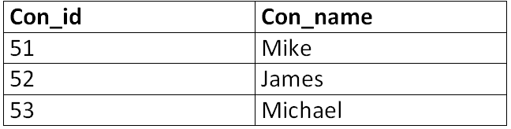

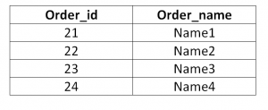
Consumer_detail
sale_detail
order_detail

Slide 209
INTRODUCTION
In last lecture, we learned how to write simple SQL statements
MySQL
Database1
Table1
Table2
Database2
Table1
Database3
Table1
SQL for manipulating a table and the data within the table
SQL for manipulating a database

Slide 210

INTRODUCTION
What if the data you need is stored in not one table but in multiple tables?
Can we display the following using SQL?
StudentId | Name | DepartmentNumber
1 | Aamir Ali | 2
2 | Sadia | 1
DepartmentNumber | Name
1 | Business
2 | IT
Student table
Department Table
StudentId | Name | DepartmentName
1 | Aamir Ali | IT
2 | Sadia | Business

Slide 211
SQL JOIN
As the name shows, JOIN means to combine something.
In case of SQL, JOIN means "to combine two or more tables".
Why SQL JOIN is used?
If you want to access more than one table through a select statement.
If you want to combine two or more tables then SQL JOIN statement is used. It combines rows of those tables in one table and one can retrieve the information by a SELECT statement.
The joining of two or more tables is based on a common field between them.
SQL INNER JOIN also known as simple join is the most common type of join.

Slide 212
JOIN
In SQL, JOIN can be used to combine the rows of two or more tables
Types of JOIN
CROSS JOIN
INNER JOIN
OUTER JOIN
SELF JOIN
MULTIPLE JOIN

Slide 213
JOIN
CROSS JOIN
With cross join, the result is obtained by combining each row from 1st table with each row from 2nd table
Name | DepartmentId
Aamir | 10
Sadaf | NULL
DepartmentId | Name
10 | IT
15 | Finance
Employee table
Department table
Result:
Name | DepartmentId | DepartmentId | Name
Aamir | 10 | 10 | IT
Sadaf | NULL | 10 | IT
Aamir | 10 | 15 | Finance
Sadaf | NULL | 15 | Finance
1
2
3
4

Slide 214
JOIN
CROSS JOIN
Cross join is often considered the simplest form of JOIN as it simply joins every row of the tables without taking any join condition into account
SQL syntax:
SELECT <column_name>, <column_name>… FROM <table_name1>, <table_name2>;

Slide 215
JOIN
CROSS JOIN
For example
The SQL would be as follows
Name | DepartmentId | DepartmentId | Name
Aamir | 10 | 10 | IT
Sadaf | NULL | 10 | IT
Aamir | 10 | 15 | Finance
Sadaf | NULL | 15 | Finance
SELECT * FROM Employee, Department;

Slide 216
JOIN
CROSS JOIN
An alternative SQL syntax
For example
SELECT <column_name>, <column_name>… FROM <table_name1> CROSS JOIN <table_name2>;
SELECT * FROM Employee CROSS JOIN Department;
SELECT * FROM Employee, Department;

Slide 217
JOIN
CROSS JOIN
When performing a JOIN, the resulting table columns can have the same column names
Both columns have the same name
Name | DepartmentId | DepartmentId | Name
Aamir | 10 | 10 | IT
Sadaf | NULL | 10 | IT
Aamir | 10 | 15 | Finance
Sadaf | NULL | 15 | Finance
Department.DepartmentId (Department table)
Employee.DepartmentId (Employee table)

Slide 218
JOIN
CROSS JOIN
For example, to display only the first two columns of the resulting cross join
SELECT Employee.Name, Employee.DepartmentId FROM Employee, Department;
Result:
Name | DepartmentId
Aamir | 10
Sadaf | NULL
Aamir | 10
Sadaf | NULL
You cannot use Name and DepartmentId here as the columns have the same name

Slide 219
JOIN
CROSS JOIN
For example, to display the first and third column of the resulting cross join
SELECT Employee.Name, Department.DepartmentId FROM Employee, Department;
Result:
Name | DepartmentId
Aamir | 10
Sadaf | 10
Aamir | 10
Sadaf | 15
You cannot use Name and DepartmentId here as the columns have the same name

Slide 220
JOIN
INNER JOIN
Inner join is the most common type of JOIN. With inner join, the result will only combine the rows of the tables if the join conditions are satisfied
SQL Syntax:
SELECT <column_name>, <column_name>… FROM <table_name1>, <table_name2> WHERE <conditions>;

Slide 221
JOIN
INNER JOIN
For example
Name | DepartmentId
Aamir | 10
Sadaf | NULL
DepartmentId | Name
10 | IT
15 | Finance
Employee table
Department table
Run:
SELECT * FROM Employee, Department WHERE Employee.DepartmentId = Department.DepartmentId;
Result:
Name | DepartmentId | DepartmentId | Name
Aamir | 10 | 10 | IT
1

Slide 222
JOIN
INNER JOIN
An alternative SQL syntax
For example
SELECT <column_name>, <column_name>… FROM <table_name1> INNER JOIN <table_name2> ON <conditions>;
SELECT * FROM Employee INNER JOIN Department ON Employee.DepartmentID = Department.DepartmentID;

Slide 223
JOIN
INNER JOIN
With inner join, if the join conditions are all based on the equal (=) operator, this type of inner join is also known as Equi-join
For example
SELECT * FROM Employee, Department WHERE Employee.DepartmentID = Department.DepartmentID;
Both inner join and equi-join

Slide 224
Activity 1
CLASS ACTIVITY
Write down the SQL for displaying the employees along with the contact number of each employee. Draw the resulting table as well
EmployeeId | Name
1 | Aamir Ali
2 | Sadia Asim
Employee table
EmployeeId | ContactNumber
1 | 111-1111
1 | 222-2222
Contact table
Answer

Slide 225
Activity 1
CLASS ACTIVITY
Answer
SELECT * FROM Employee, Contact WHERE Employee.EmployeeID = Contact.EmployeeID;
Resulting table:
EmployeeId | Name | EmployeeId | ContactNumber
1 | Aamir Ali | 1 | 111-1111
1 | Aamir Ali | 1 | 222-2222

Slide 226
JOIN
OUTER JOIN
Outer join is a variation of inner join where in some cases, the rows will be displayed in the result even if the join conditions are not satisfied
Types of outer join
LEFT OUTER JOIN
RIGHT OUTER JOIN
FULL OUTER JOIN

Slide 227
JOIN
LEFT OUTER JOIN
Left outer join is like inner join except all the rows in the left table are always returned in the result even if the rows do not satisfy the join conditions
SQL Syntax:
SELECT <column_name>, <column_name>… FROM <left_table_name> LEFT JOIN <right_table_name> ON <conditions>;

Slide 228
JOIN
LEFT OUTER JOIN
Name | DepartmentId
Aamir | 10
Sadaf | NULL
DepartmentId | Name
10 | IT
15 | Finance
Employee table
Department table
Run:
SELECT * FROM Employee LEFT JOIN Department ON Employee.DepartmentId = Department.DepartmentId;
Result:
Name | DepartmentId | DepartmentId | Name
Aamir | 10 | 10 | IT
Sadaf | NULL | NULL | NULL
1
2

Slide 229
JOIN
RIGHT OUTER JOIN
Right outer join is like inner join except all the rows in the right table are always returned in the result even if the rows do not satisfy the join conditions
SQL Syntax:
SELECT <column_name>, <column_name>… FROM <left_table_name> RIGHT JOIN <right_table_name> ON <conditions>;

Slide 230
JOIN
RIGHT OUTER JOIN
Name | DepartmentId
Aamir | 10
Sadaf | NULL
DepartmentId | Name
10 | IT
15 | Finance
Employee table
Department table
Run:
SELECT * FROM Employee RIGHT JOIN Department ON Employee.DepartmentId = Department.DepartmentId;
Result:
Name | DepartmentId | DepartmentId | Name
Aamir | 10 | 10 | IT
NULL | NULL | 15 | Finance
1
2

Slide 231
JOIN
FULL OUTER JOIN
Full outer join is like inner join except all the rows in the left and right table are always returned even if the rows do not satisfy the join conditions
SQL Syntax:
MySQL does not support full outer join
SELECT <column_name>, <column_name>… FROM <left_table_name> FULL OUTER JOIN <right_table_name> ON <conditions>;

Slide 232
JOIN
FULL OUTER JOIN
Name | DepartmentId
Aamir | 10
Sadaf | NULL
DepartmentId | Name
10 | IT
15 | Finance
Employee table
Department table
Run:
SELECT * FROM Employee FULL OUTER JOIN Department ON Employee.DepartmentId = Department.DepartmentId;
Result:
Name | DepartmentId | DepartmentId | Name
Aamir | 10 | 10 | IT
Sadaf | NULL | NULL | NULL
NULL | NULL | 15 | Finance
1
2
3

Slide 233
JOIN
SELF JOIN
Self join is when a table is joined with itself
Since both tables have the same name, we need a way to distinguish between the two tables. The solution is to give each table an alias in SQL:
SELECT <column_name>, <column_name>… FROM <table_name> <alias_1>, <table_name> <alias_2> WHERE <conditions>;

Slide 234
JOIN
SELF JOIN
DepartmentId | Name
10 | IT
15 | Finance
DepartmentId | Name
10 | IT
15 | Finance
Department table
Department table
Run:
SELECT D.DepartmentId, D.Name, E.DepartmentId, E.Name FROM Department D, Department E WHERE D.DepartmentId > E.DepartmentId;
Left table is called D, right table is called E
Result:
DepartmentId | Name | DepartmentId | Name
15 | Finance | 10 | IT
1

Slide 235
JOIN
MULTIPLE JOIN
Multiple join is when we join more than two tables
For example
ICNumber | DepartmentId
12345 | 10
54321 | NULL
DepartmentId | Name
10 | IT
15 | Finance
Employee table
Department Table
ICNumber | Salary
12345 | 3000
54321 | 3500
Salary Table

Slide 236
JOIN
MULTIPLE JOIN
Run:
SELECT Employee.ICNumber, Department.Name, Salary.Salary FROM Employee, Department, Salary WHERE Employee.DepartmentId = Department.DepartmentId AND Employee.ICNumber = Salary.ICNumber;
Result:
ICNumber | Name | Salary
12345 | IT | 3000

Slide 237
UNION
In SQL, UNION can be used to combine the results of two or more SELECT statements under the condition that the statements
Have the same number of columns
Have similar data type
SQL Syntax:
<select statement> UNION <select statement> UNION <select statement>…;

Slide 238
UNION
ICNumber | Name
12345 | Aamir Ali
54321 | Sadaf Amin
ICNumber | Name
12345 | Aamir Ali
32145 | Imran Anwer
Employee_HEC table
Employee_ApComs table
Run:
SELECT Name FROM Employee_HEC UNION SELECT Name FROM Employee_ApComs;
This is a valid UNION. Both SELECT produce same number of columns (1 column) and same data type (VARCHAR)
Result:
Name
Aamir Ali
Sadaf Amin
Imran Anwer
Aamir Ali
is listed only once as UNION does not list duplicates rows

Slide 239
UNION
ICNumber | Name
12345 | Aamir Ali
54321 | Sadaf Amin
ICNumber | Name
12345 | Aamir Ali
32145 | Imran Anwer
Employee_HEC table
Employee_ApComs table
Run:
SELECT Name FROM Employee_HEC UNION ALL SELECT Name FROM Employee_ApComs;
Result:
Name
Aamir Ali
Sadaf Amin
Aamir Ali
Imran Anwer
Aamir Ali is listed twice as UNION ALL allows duplicated rows

Slide 240

INTRODUCTION
A function is a part of a larger program that performs a specific task
For example in Microsoft Word
Function that bolded words
Function that changes font size
Function that highlight words

Slide 241
INTRODUCTION
The SQL standard has defined a number of standard functions to perform common data manipulation tasks
For example, there is a SQL function that changes all the letters to upper case
There is a SQL function to extract the year from a date
Hello
HELLO
2012-04-26
2012

Slide 242
INTRODUCTION
These SQL functions are grouped into four categories
Math Functions
String Functions
Date Functions
Aggregate Functions

Slide 243
Math Functions
SQL supports the use of basic math operators in SQL statements
Function | Operator
Add | +
Subtract | -
Multiply | *
Divide | /

Slide 244
Math Functions
For example
ISBN | Title | Quantity
12345 | The Hunger Game | 10
54321 | A Song of Ice and Fire | 15
Book table
Run:
SELECT ISBN, Title, (Quantity + 3) * 2 FROM Book;
Result:
ISBN | Title | (Quantity + 3) * 2
12345 | The Hunger Game | 26
54321 | A Song of Ice and Fire | 36
Column name has changed

Slide 245
Math Functions
For example
ISBN | Title | Quantity
12345 | The Hunger Game | 10
54321 | A Song of Ice and Fire | 15
Book table
Run:
SELECT ISBN, Title, (Quantity + 3) * 2 AS Quantity FROM Book;
Column has been renamed by using AS in SQL statement
Result:
ISBN | Title | Quantity
12345 | The Hunger Game | 26
54321 | A Song of Ice and Fire | 36

Slide 246
Math Functions
In this chapter, we will examine the following math functions
ABS()
POWER()
SQRT()
ROUND()
CEILING()
FLOOR()

Slide 247
Math Functions
ABS()
ABS() – Display the absolute value of number
ISBN | Title | Quantity
12345 | The Hunger Game | 10
54321 | A Song of Ice and Fire | 15
Book table
Run:
SELECT ISBN, Quantity - 13, ABS(Quantity - 13) FROM Book;
Result:
ISBN | Quantity - 13 | ABS(Quantity – 13)
12345 | -3 | 3
54321 | 2 | 2

Slide 248
Math Functions
POWER()
POWER() – Raise number to specific power
ISBN | Title | Quantity
12345 | The Hunger Game | 10
54321 | A Song of Ice and Fire | 15
Book table
Run:
SELECT ISBN, POWER(Quantity, 2), POWER(Quantity, 3) FROM Book;
Result:
ISBN | POWER(Quantity, 2) | POWER(Quantity, 3)
12345 | 100 | 1000
54321 | 255 | 3375

Slide 249
Math Functions
SQRT()
SQRT() – Display the square root of number
ISBN | Title | Quantity
12345 | The Hunger Game | 10
54321 | A Song of Ice and Fire | 15
Book table
Run:
SELECT ISBN, Quantity, SQRT(Quantity) FROM Book;
Result:
ISBN | Quantity | SQRT(Quantity)
12345 | 10 | 3.16228
54321 | 15 | 3.87298

Slide 250
Math Functions
ROUND()
ROUND() – Display rounded number
ISBN | Title | Price
12345 | The Hunger Game | 20.50
54321 | A Song of Ice and Fire | 30.40
Book table
Run:
SELECT ISBN, Price, ROUND(Price) FROM Book;
Result:
ISBN | Price | ROUND(Price)
12345 | 20.50 | 21
54321 | 30.40 | 30

Slide 251
Math Functions
CEILING()
CEILING() – Round up the fractional number
ISBN | Title | Price
12345 | The Hunger Game | 20.50
54321 | A Song of Ice and Fire | 30.40
Book table
Run:
SELECT ISBN, Price, CEILING(Price) FROM Book;
Result:
ISBN | Price | CEILING(Price)
12345 | 20.50 | 21
54321 | 30.40 | 31

Slide 252
Math Functions
FLOOR()
FLOOR() – Round down the fractional number
ISBN | Title | Price
12345 | The Hunger Game | 20.50
54321 | A Song of Ice and Fire | 30.40
Book table
Run:
SELECT ISBN, Price, FLOOR (Price) FROM Book;
Result:
ISBN | Price | FLOOR(Price)
12345 | 20.50 | 20
54321 | 30.40 | 30

Slide 253
Activity 1
CLASS ACTIVITY
Write down the result of executing the following SQL statements
SELECT SQRT(Spaces), ROUND(Cost), CEILING(Cost), FLOOR(Cost) FROM Course;
Date | Name | Spaces | Cost
2011-12-12 | Database | 25 | 300.99
Course table
Answer
SQRT(Spaces) | ROUND(Cost) | CEILING(Cost) | FLOOR(Cost)
5 | 301 | 301 | 300

Slide 254
String Functions
A string is basically a sequence of characters (i.e. CHAR or VARCHAR)
In terms of positioning, each character of the string occupies a position
Position | 1 | 2 | 3 | 4 | 5 | 6 | 7 | 8 | 9 | 10 | 11 | 12
Character | H | A | R | R | Y |  | P | O | T | T | E | R
R occupies position 3
T occupies position 10

Slide 255
String Functions
In this chapter, we will examine the following string functions
SUBSTRING()
UPPER()
LOWER()
REVERSE()
LENGTH()

Slide 256
String Functions
SUBSTRING()
SUBSTRING() – Extract part of a string
ISBN | Title | Quantity
12345 | The Hunger Game | 10
54321 | A Song of Ice and Fire | 15
This is the starting position
Book table
Run:
SELECT ISBN, SUBSTRING(Title, 3, 4) FROM Book;
This is the number of characters
Result:
ISBN | SUBSTRING(Title, 3, 4)
12345 | e Hu
54321 | Song

Slide 257
String Functions
UPPER()
UPPER() – Change the string to upper case
ISBN | Title | Quantity
12345 | The Hunger Game | 10
54321 | A Song of Ice and Fire | 15
Book table
Run:
SELECT ISBN, UPPER(Title) FROM Book;
Result:
ISBN | UPPER(Title)
12345 | THE HUNGER GAME
54321 | A SONG OF ICE AND FIRE

Slide 258
String Functions
LOWER()
LOWER() – Change the string to lower case
ISBN | Title | Quantity
12345 | The Hunger Game | 10
54321 | A Song of Ice and Fire | 15
Book table
Run:
SELECT ISBN, LOWER(Title) FROM Book;
Result:
ISBN | LOWER(Title)
12345 | the hunger game
54321 | a song of ice and fire

Slide 259
String Functions
REVERSE()
REVERSE() – Reverse the order of characters
ISBN | Title | Quantity
12345 | The Hunger Game | 10
54321 | A Song of Ice and Fire | 15
Book table
Run:
SELECT ISBN, REVERSE(Title) FROM Book;
Result:
ISBN | REVERSE(Title)
12345 | emaG regnuH ehT
54321 | eriF dna ecI fo gnoS A

Slide 260
String Functions
LENGTH()
LENGTH() – Count number of characters
ISBN | Title | Quantity
12345 | The Hunger Game | 10
54321 | A Song of Ice and Fire | 15
Book table
Run:
SELECT ISBN, LENGTH(Title) FROM Book;
Note: A space is considered to be a character
Result:
ISBN | LENGTH(Title)
12345 | 15
54321 | 22

Slide 261
Activity 2
CLASS ACTIVITY
Write down the result of executing the following SQL statements
SELECT SUBSTRING(Name, 5, 4), UPPER(Name), LENGTH(Name) FROM Course;
Date | Name | Spaces | Cost
2011-12-12 | Database | 25 | 300.99
Course table
Answer
SUBSTRING(Name, 5, 4) | UPPER(Name) | LENGTH(Name)
base | DATABASE | 8

Slide 262
Date Functions
SQL considers date and time as consisting of the following parts
The parts can be used in SQL date functions
PARTS
MICROSECOND | SECOND
MINUTE | HOUR
DAY | WEEK
MONTH | QUARTER
YEAR

Slide 263
Date Functions
In this chapter, we will examine the following date functions
NOW()
EXTRACT()
DATE_ADD()
DATE_SUB()
DATEDIFF()

Slide 264
Date Functions
NOW()
NOW() – Returns the current date and time
ISBN | Title | Published
12345 | The Hunger Game | 2008-10-11 12:12:33
Book table
Run:
INSERT INTO Book VALUES(54321, ‘A Song of Ice and Fire', NOW());
This is the date and time the INSERT statement executed
Result:
ISBN | Title | Published
12345 | The Hunger Game | 2008-10-11 12:12:33
54321 | A Song of Ice and Fire | 2018-02-01 09:45:00

Slide 265
Date Functions
EXTRACT()
EXTRACT() – Extract a part of date and time
ISBN | Title | Published
12345 | The Hunger Game | 2008-10-11
54321 | A Song of Ice and Fire | 2012-11-28
Book table
Run:
SELECT ISBN, Title, EXTRACT(YEAR FROM Published) AS Year FROM Book;
Result:
ISBN | Title | Year
12345 | The Hunger Game | 2008
54321 | A Song of Ice and Fire | 2012

Slide 266
Date Functions
EXTRACT()
EXTRACT() – Extract a part of date and time
ISBN | Title | Published
12345 | The Hunger Game | 2008-10-11
54321 | A Song of Ice and Fire | 2012-11-28
Book table
Run:
SELECT ISBN, Title, EXTRACT(MONTH FROM Published) AS Month FROM Book;
Result:
ISBN | Title | Month
12345 | The Hunger Game | 10
54321 | A Song of Ice and Fire | 11

Slide 267
Date Functions
EXTRACT()
EXTRACT() – Extract a part of date and time
ISBN | Title | Published
12345 | The Hunger Game | 2008-10-11
54321 | A Song of Ice and Fire | 2012-11-28
Book table
Run:
SELECT ISBN, Title, EXTRACT(DAY FROM Published) AS Day FROM Book;
Result:
ISBN | Title | Day
12345 | The Hunger Game | 11
54321 | A Song of Ice and Fire | 28

Slide 268
Date Functions
DATE_ADD()
DATE_ADD() – Adds a time interval
ISBN | Title | Published
12345 | The Hunger Game | 2008-10-11
54321 | A Song of Ice and Fire | 2012-11-28
Book table
Run:
SELECT ISBN, Title, DATE_ADD(Published, INTERVAL 5 DAY) AS Published FROM Book;
Result:
ISBN | Title | Published
12345 | The Hunger Game | 2008-10-16
54321 | A Song of Ice and Fire | 2012-12-03

Slide 269
Date Functions
DATE_SUB()
DATE_SUB() – Subtracts a time interval
ISBN | Title | Published
12345 | The Hunger Game | 2008-10-11 12:12:33
54321 | A Song of Ice and Fire | 2012-11-28 10:33:00
Book table
Run:
SELECT ISBN, Title, DATE_SUB(Published, INTERVAL 3 HOUR) AS Published FROM Book;
Result:
ISBN | Title | Published
12345 | The Hunger Game | 2008-10-11 09-12:33
54321 | A Song of Ice and Fire | 2012-11-28 07:33:00

Slide 270
Date Functions
DATEDIFF()
DATEDIFF() – Calculates difference in days
JourneyId | Start | End
1 | 2011-11-12 12:12:33 | 2011-11-15 12:12:33
2 | 2011-11-12 12:12:33 | 2011-11-18 17:01:53
Journey table
Run:
SELECT JourneyId, DATEDIFF(End, Start) AS Duration FROM Journey;
Result:
JourneyId | Duration
1 | 3
2 | 6

Slide 271
Activity 3
CLASS ACTIVITY
Write down the result of executing the following SQL statements
SELECT EXTRACT(YEAR FROM Date) AS Year, EXTRACT(DAY FROM Date) AS Day, DATE_ ADD(Date, INTERVAL 1 MONTH) FROM Course;
Date | Name | Spaces | Cost
2011-12-12 | Database | 25 | 300.99
Course table
Answer
Year | Day | DATE_ ADD(Date, INTERVAL 1 MONTH)
2011 | 12 | 2012-01-12

Slide 272
Aggregate Functions
An aggregate function grouped together the values of multiple rows to form a single value
For example
Aggregate functions can be used to count the number of books in the table or to calculate the total book quantity
ISBN | Title | Quantity
12345 | The Hunger Game | 10
54321 | A Song of Ice and Fire | 15
Book table

Slide 273
Aggregate Functions
In this chapter, we will examine the following aggregate functions
COUNT()
SUM()
AVG()
MAX()
MIN()

Slide 274
Aggregate Functions
COUNT()
COUNT(*) – Counts number of rows in a table
ISBN | Title | Quantity
12345 | The Hunger Game | 10
54321 | A Song of Ice and Fire | NULL
Book table
Run:
SELECT COUNT(*) FROM Book;
Result:
COUNT(*)
2

Slide 275
Aggregate Functions
COUNT()
COUNT(<column_name>) – Counts number of non NULL rows in a column
ISBN | Title | Quantity
12345 | The Hunger Game | 10
54321 | A Song of Ice and Fire | NULL
Book table
Run:
SELECT COUNT(ISBN), COUNT(Quantity) FROM Book;
Result:
COUNT(ISBN) | COUNT(Quantity)
2 | 1

Slide 276
Aggregate Functions
SUM()
SUM() – Add up a column’s numeric value
ISBN | Title | Quantity
12345 | The Hunger Game | 10
54321 | A Song of Ice and Fire | 15
Book table
Run:
SELECT SUM(Quantity) AS Total FROM Book;
Result:
Total
25

Slide 277
Aggregate Functions
AVG()
AVG() – Average a column’s numeric value
ISBN | Title | Quantity
12345 | The Hunger Game | 10
54321 | A Song of Ice and Fire | 15
Book table
Run:
SELECT AVG(Quantity) AS Average FROM Book;
Result:
Average
12.5000

Slide 278
Aggregate Functions
MAX()
MAX() – Returns the largest value in a column
ISBN | Title | Quantity
12345 | The Hunger Game | 10
54321 | A Song of Ice and Fire | 15
Book table
Run:
SELECT MAX(Quantity) AS Maximum FROM Book;
Result:
Maximum
15

Slide 279
Aggregate Functions
MIN()
MIN() – Returns the smallest value in a column
ISBN | Title | Quantity
12345 | The Hunger Game | 10
54321 | A Song of Ice and Fire | 15
Book table
Run:
SELECT MIN(Quantity) AS Minimum FROM Book;
Result:
Minimum
10

Slide 280
Activity 4
CLASS ACTIVITY
Write down the result of executing the following SQL statements
SELECT COUNT(*), SUM(Spaces), MAX(Cost), MIN(Cost) FROM Course;
Date | Name | Spaces | Cost
2011-12-12 | Database | 25 | 300.99
2012-01-13 | Java | 30 | 199.49
Course table
Answer
COUNT(*) | SUM(Spaces) | MAX(Cost) | MIN(Cost)
2 | 55 | 300.99 | 199.49

Slide 281
INTRODUCTION
A database designer is responsible for the design of the database system
Responsibilities:
Data modelling using EER diagram
Relational database design and normalization

Slide 282
INTRODUCTION
A database administrator (DBA) is responsible for managing the DBMS.
This ensures that the database system is functioning properly at all times.

Slide 283
General Database Administration
A DBA is responsible for
Server startup, shutdown and upgrade
User account maintenance
Log maintenance
Server configuration and tuning
Multiple server management

Slide 284

General Database Administration
Server startup, shutdown and upgrade
A server may freeze, hang or even crashes
A DBA therefore needs to be able to startup and shutdown the DBMS as the need arises

Slide 285
General Database Administration
Server startup, shutdown and upgrade
When a new version of DBMS is released, a DBA needs to be able to weigh the cost vs. the benefit of performing a DBMS upgrade

Slide 286
General Database Administration
User account maintenance
A DBA should allocate user accounts for each database system user. Doing so would allow us to
Keep track of account user’s activity
Restrict data access by account user

Slide 287

General Database Administration
Log maintenance
A log is basically a file (or several files) that is maintained by the server on the actions that have occurred so far on the server
A DBA should know which DBMS logs are important to keep and which are not
If a log is no longer needed (e.g. it records actions from 10 years ago), it should be deleted to save disk space
Important
Important
Figure 07

Slide 288

General Database Administration
Server configuration and tuning
A DBMS can only perform at its best through careful configuration and tuning
As a DBA, your responsibility is to decide
Is more memory needed?
Is faster disk needed?
Should we optimize for INSERT or SELECT?
…

Slide 289


General Database Administration
Multiple server management
Database Servers
Know how to setup and manage multiple database servers
DBA

Slide 290

Database Security
A DBA is in charge of the security of the database system
Two security areas that a DBA should worry about are
File system Security
Database Server Security

Slide 291

Database Security
File system Security
A database system stores all of its data in regular computer files
To break security, all one needs to do is to copy all of the files to an external storage device (e.g. pen drive).

Slide 292
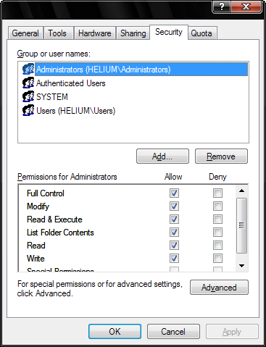
Database Security
File system Security
As a DBA, you must enforce filesystem security by limiting access to the data files
For example
Set the permissions so that only DBAs and nobody else have access to the folder containing the data files

Slide 293
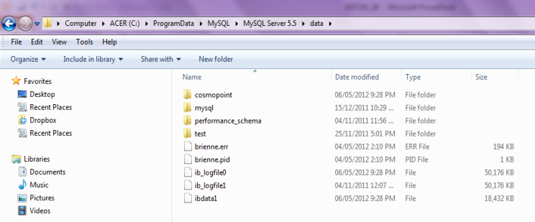
Database Security
File system Security
On Windows, the MySQL Community Server typically stores the data files in the folder
C:\ProgramData\MySQL\MySQL Server 5.5\data
Each folder is a database. In each folder, MySQL stores the database’s tables and data

Slide 294
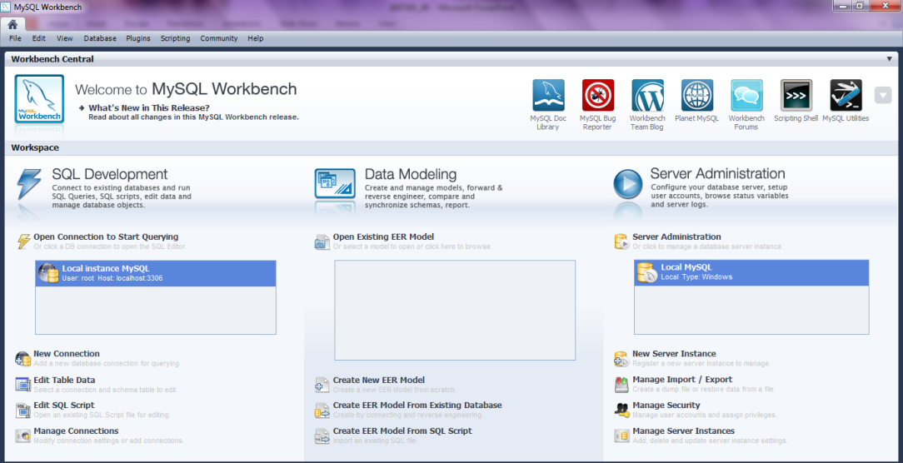
Database Security
Database Server Security
A DBA can enforce database server security through the setup of user accounts
MySQL Workbench provides a point-and-click interface for the setting up of user accounts
Double click here to access MySQL Workbench’s database administration functionalities

Slide 295
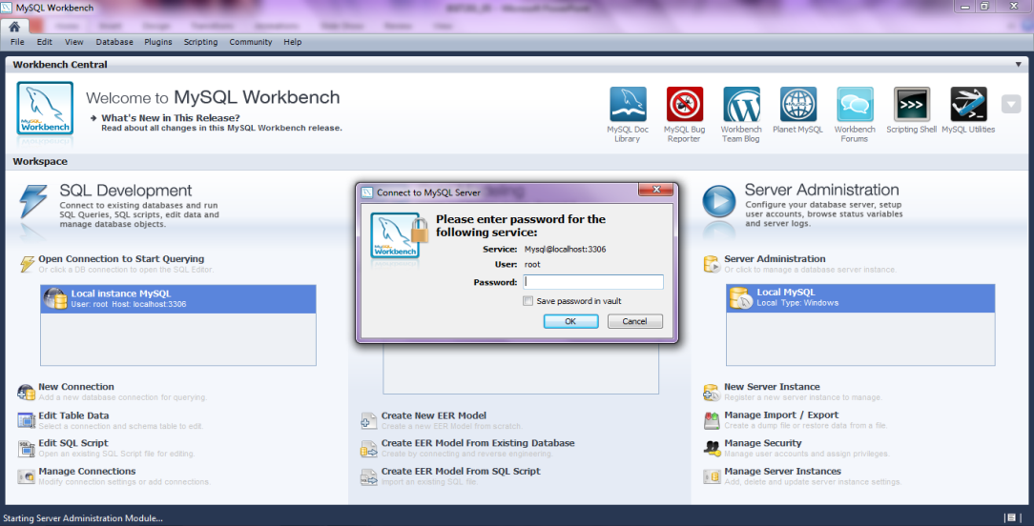
Database Security
Database Server Security
MySQL Workbench provides a point-and-click interface for database administration
Enter your password for MySQL

Slide 296
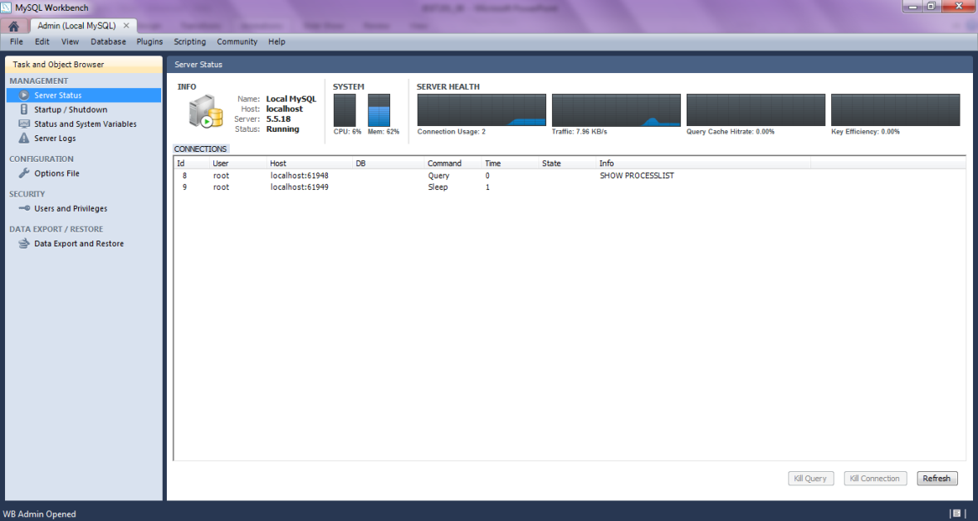
Database Security
Database Server Security
Database administration main screen
Click on “Users and Privileges” to access MySQL’s security features

Slide 297
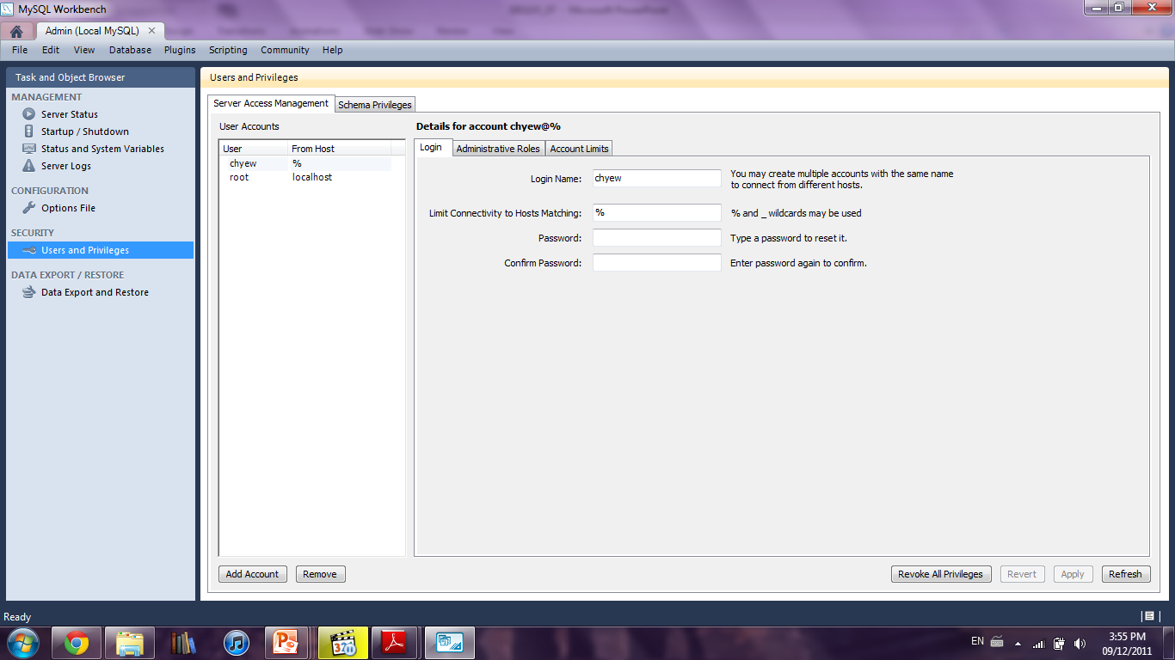
Database Security
Database Server Security
“Server Access Management” screen
Limit MySQL access to only certain computers (e.g. only office computers can access MySQL)
You can create new user account
Figure 13

Slide 298
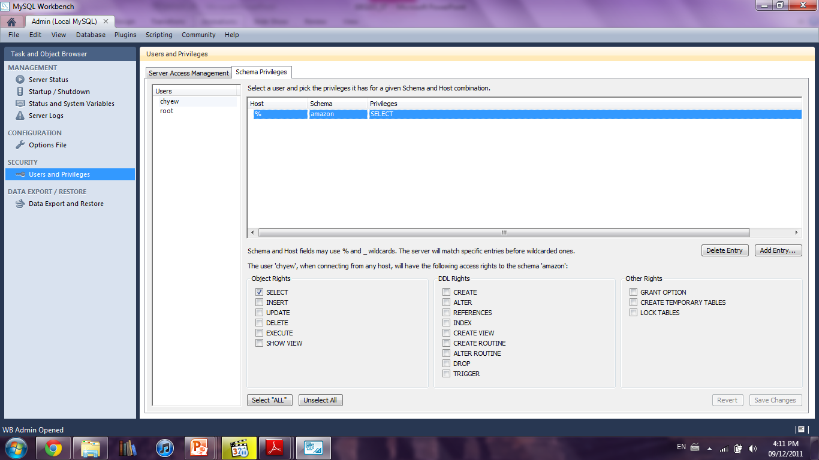
Database Security
Database Server Security
“Schema Privileges” screen
Configure which database each user can access
Configure the SQL that each user can execute

Slide 299
Database Security
Database Server Security
What about the “root” user account that we have been using so far to login to MySQL?
A root account is a special user account that is automatically created for you during MySQL installation
It is the most privileged account as there is no restriction placed on the account
You should use the root account to create more restricted user accounts for daily use
Figure 13

Slide 300
Database Backup
Database backup is the process of making a complete secondary copy of a database for the purpose of recovering the database following a disaster
As a DBA, you should know the two forms of backup
Binary Backup
Text-Format Backup

Slide 301

Database Backup
Binary Backup
Binary backup involves the copying of the data files of the database to one or more data repositories for safe keeping

Slide 302

Database Backup
Binary Backup
When disaster struck and data is lost, a DBA can then restore the lost data by replacing the database files with the previously backup files

Slide 303

Database Backup
Text-Format Backup
Text-format backup involves the creation of backup files that contain SQL on how to recreate databases, tables and data
CREATE DATABASE IF NOT EXISTS `amazon`
USE `amazon`;
DROP TABLE IF EXISTS `book`;
CREATE TABLE `book` (
`ISBN` int(11) NOT NULL PRIMARY KEY,
`Title` varchar(100) DEFAULT NULL,
`Quantity` int(11) DEFAULT '10',
) ENGINE=InnoDB DEFAULT CHARSET=latin1;
…

Slide 304
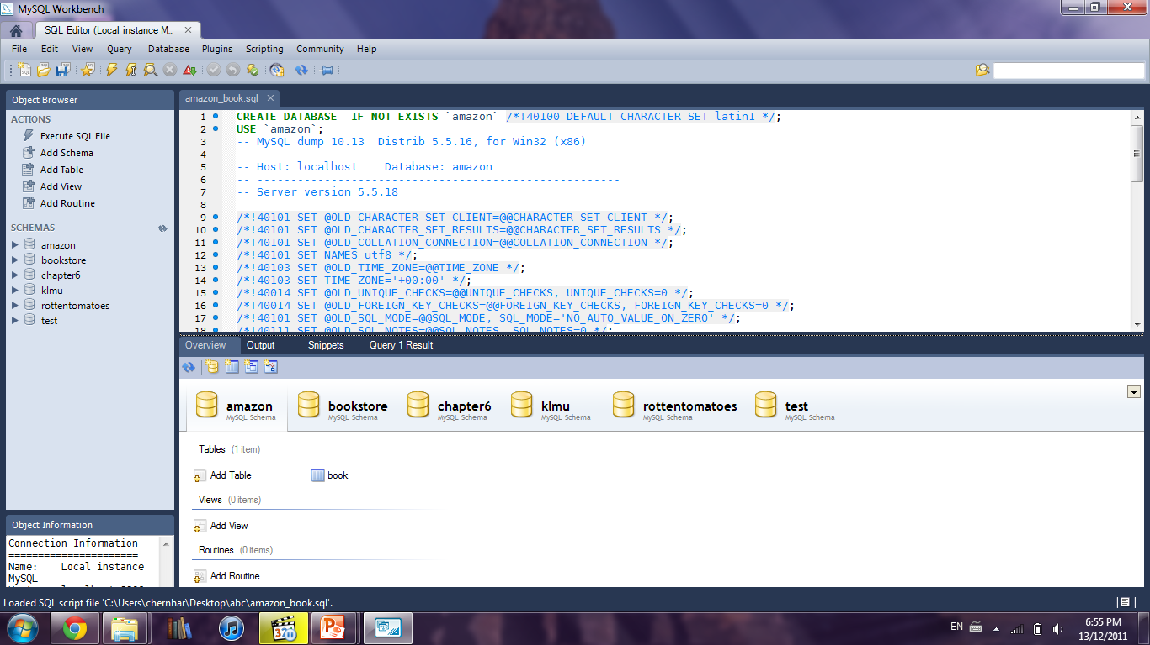
Database Backup
Text-Format Backup
When disaster struck and data is lost, a DBA can then restore the lost data by executing the SQL in the backup files
SQL from backup file
Execute the SQL to restore loss data

Slide 305
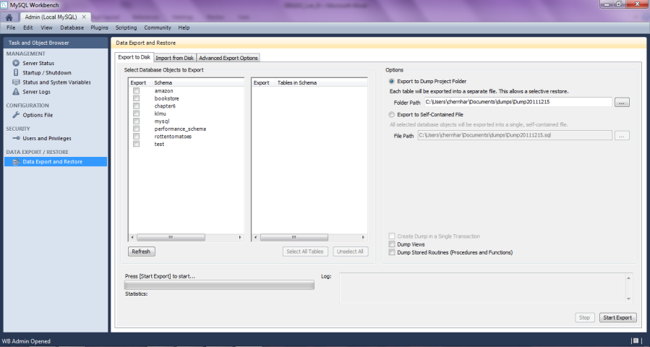
Database Backup
Text-Format Backup
In MySQL Workbench, you can perform text-format backup by accessing “Data Export and Restore”
Select database to backup
Select tables within a database to backup
Start backup

Slide 306
Database Backup
Comparison between binary backup and text-format backup
 | Binary Backup | Text-Format Backup
Backup | Copying of data files | Creation of SQL files
Restore | Copying of data files | Execute the SQL in the backup files
Speed | Fast (All one is doing is file copy) | Slow (Generating SQL, not suitable for large database)
Database server shutdown | Often required (Copying database files while the files are being updated by DBMS may corrupt the database’s data) | Not required

Slide 307
Database Replication
Database replication is a way to ensure data consistency among many database servers (i.e. servers should eventually store the same data)
Master server
With database replication, a DBA needs to setup one of the many database servers as the master server

Slide 308
Database Replication
Database replication is a way to ensure data consistency among many database servers (i.e. all servers should eventually store the same data)
Slave server
Master server
Slave server
The DBA should then setup the rest of the database servers as slave servers

Slide 309
Database Replication
Database replication is a way to ensure data consistency among many database servers (i.e. all servers should eventually store the same data)
Slave server
Master server
Slave server
The way database replication works is for all data insert/update/delete to always go through the master server

Slide 310
Database Replication
Database replication is a way to ensure data consistency among many database servers (i.e. all servers should eventually store the same data)
Slave server
Master server
Slave server
After the master server has updated its database, it would then propagate the update to the slave servers

Slide 311
Database Replication
Database replication is a way to ensure data consistency among many database servers (i.e. all servers should eventually store the same data)
Slave server
Master server
Slave server
The slave servers would then update their database and now all the database servers would store the same data

Slide 312
Database Replication
Database replication is a way to ensure data consistency among many database servers (i.e. all servers should eventually store the same data)
Slave server
Master server
Slave server
As for displaying data, you can display data from either master or slaves. Sometimes, you may display outdated data if a slave has not received its update from the master

Slide 313
Database Replication
Why database replication?
Scenario: Suppose there is a network failure and the data are no longer consistent among servers
No master-slaves
6 employees
5 employees
7 employees
No way to tell which server contains latest data

Slide 314
Database Replication
Why database replication?
Scenario: Suppose there is a network failure and the data are no longer consistent among servers
Master-slaves
6 employees
Slave server
5 employees
Master server
Slave server
7 employees
The master server would contain the latest data since we always write to the master server first

Slide 315
Database Replication
Why database replication?
Scenario: Suppose there is a network failure and the data are no longer consistent among servers
Master-slaves
6 employees
Slave server
6 employees
Master server
Slave server
6 employees
To fix the data inconsistency, all the slave servers need to do is to update its database based on that of the master

Slide 316
Database Replication
Advantages of database replication
Improve Availability
Improve Performance
Local Database Access
Backup without Lost of Database Access

Slide 317
Database Replication
Improve Availability
With one database server, if it crashes, you end up losing access to all of your data
With database replication
Slave server
Master server
Slave server
If a slave server crashes

Slide 318
Database Replication
Improve Availability
With one database server, if it crashes, you end up losing access to all of your data
With database replication
Crashed server
Master server
Slave server
The other servers would keep functioning

Slide 319
Database Replication
Improve Availability
With one database server, if it crashes, you end up losing access to all of your data
With database replication
Slave server
Master server
Slave server
Upon slave server recovery, it would simply get its updates from the master

Slide 320
Database Replication
Improve Availability
With one database server, if it crashes, you end up losing access to all of your data
With database replication
Slave server
Master server
Slave server
If the master server crashes

Slide 321
Database Replication
Improve Availability
With one database server, if it crashes, you end up losing access to all of your data
With database replication
Slave server
Crashed server
Master server
Choose a new master server from among the slaves and continue on

Slide 322
Database Replication
Improve Performance
As there are now multiple database servers, any request to display data can now be executed on the “best” server
Busy
Busy
Busy
Free
Busy
Displaying data from the free server should be faster since it is not busy. This is not possible if we only have one database server

Slide 323

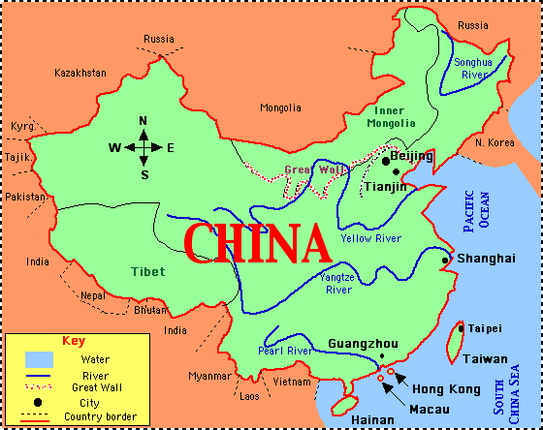

Database Replication
Local Database Access
A slave database server can be placed anywhere in the world
For example
Master server
Displaying data through such long distance can be slow

Slide 324
Database Replication
Local Database Access
A slave database server can be placed anywhere in the world
For example
Master server
Master server updates slave server with latest data
Slave server
Displaying data in China through the slave server is faster since it is local

Slide 325
Database Replication
Backup without Lost of Database Access
Binary backup often means the lost of data access as the server needs to be shut down
With database replication
Slave server
Performing binary backup…
Master server
Slave server
Shutdown one slave server to perform binary backup. Data access not affected

